Slide 1
12/14/20 - plots
Difference (FHIST_Contrail - FHIST) plots
ordered by area, variable, level
level ranges from 16 to 18
Four areas
Hawaii to LA
Eastern US
Western Europe
East Asia

Slide 2
Abbreviations and units
Abbreviation | Measurement | Units
AREI | Average ice effective radius | micron
CLOUD | Cloud fraction | N/A
IWC | Grid box average ice water content | kg/m³
T | Temperature | K

Slide 3
Levels and pressures
Level | Pressure (hPa) | Level | Pressure (hPa)
0 | 3.64346569404006 | 16 | 273.9108167588711
1 | 7.594819646328688 | 17 | 322.2419023513794
2 | 14.356632251292467 | 18 | 379.10090386867523
3 | 24.612220004200935 | 19 | 445.992574095726
4 | 35.92325001955032 | 20 | 524.6871747076511
5 | 43.1937500834465 | 21 | 609.7786948084831
6 | 51.67749896645546 | 22 | 691.3894303143024
7 | 61.52049824595451 | 23 | 763.404481112957
8 | 73.75095784664154 | 24 | 820.8583686500788
9 | 87.82123029232025 | 25 | 859.5347665250301
10 | 103.31712663173676 | 26 | 887.0202489197254
11 | 121.54724076390266 | 27 | 912.644546944648
12 | 142.99403876066208 | 28 | 936.1983984708786
13 | 168.22507977485657 | 29 | 957.485479535535
14 | 197.9080867022276 | 30 | 976.325407391414
15 | 232.82861895859241 | 31 | 992.556095123291

Slide 4
AREI: Hawaii to LA

Slide 5
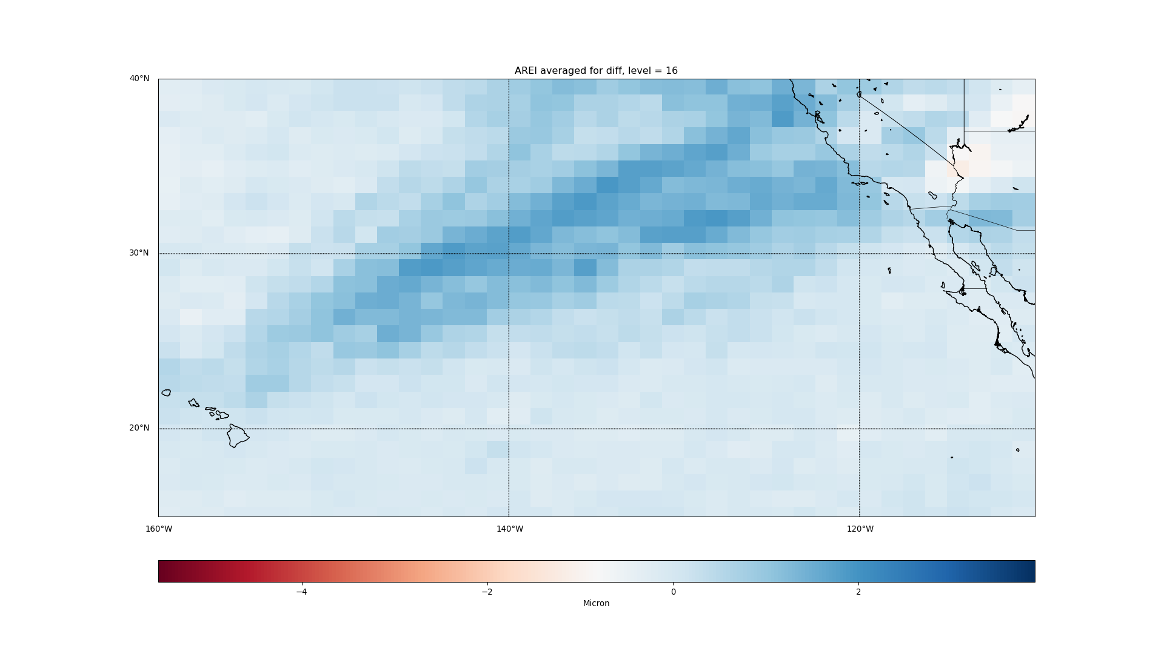

Slide 6
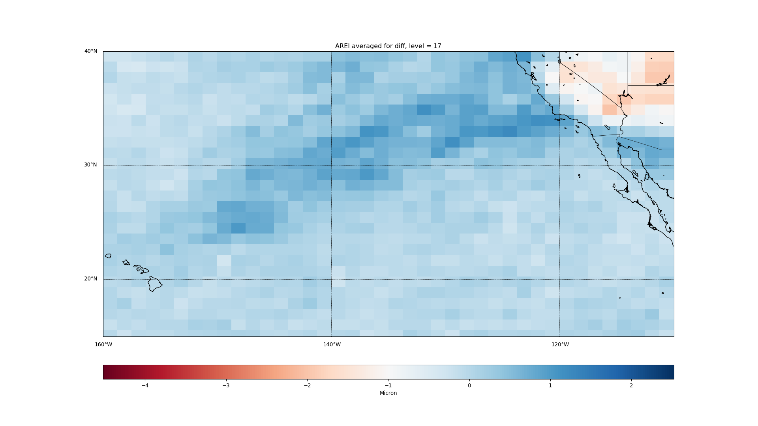

Slide 7
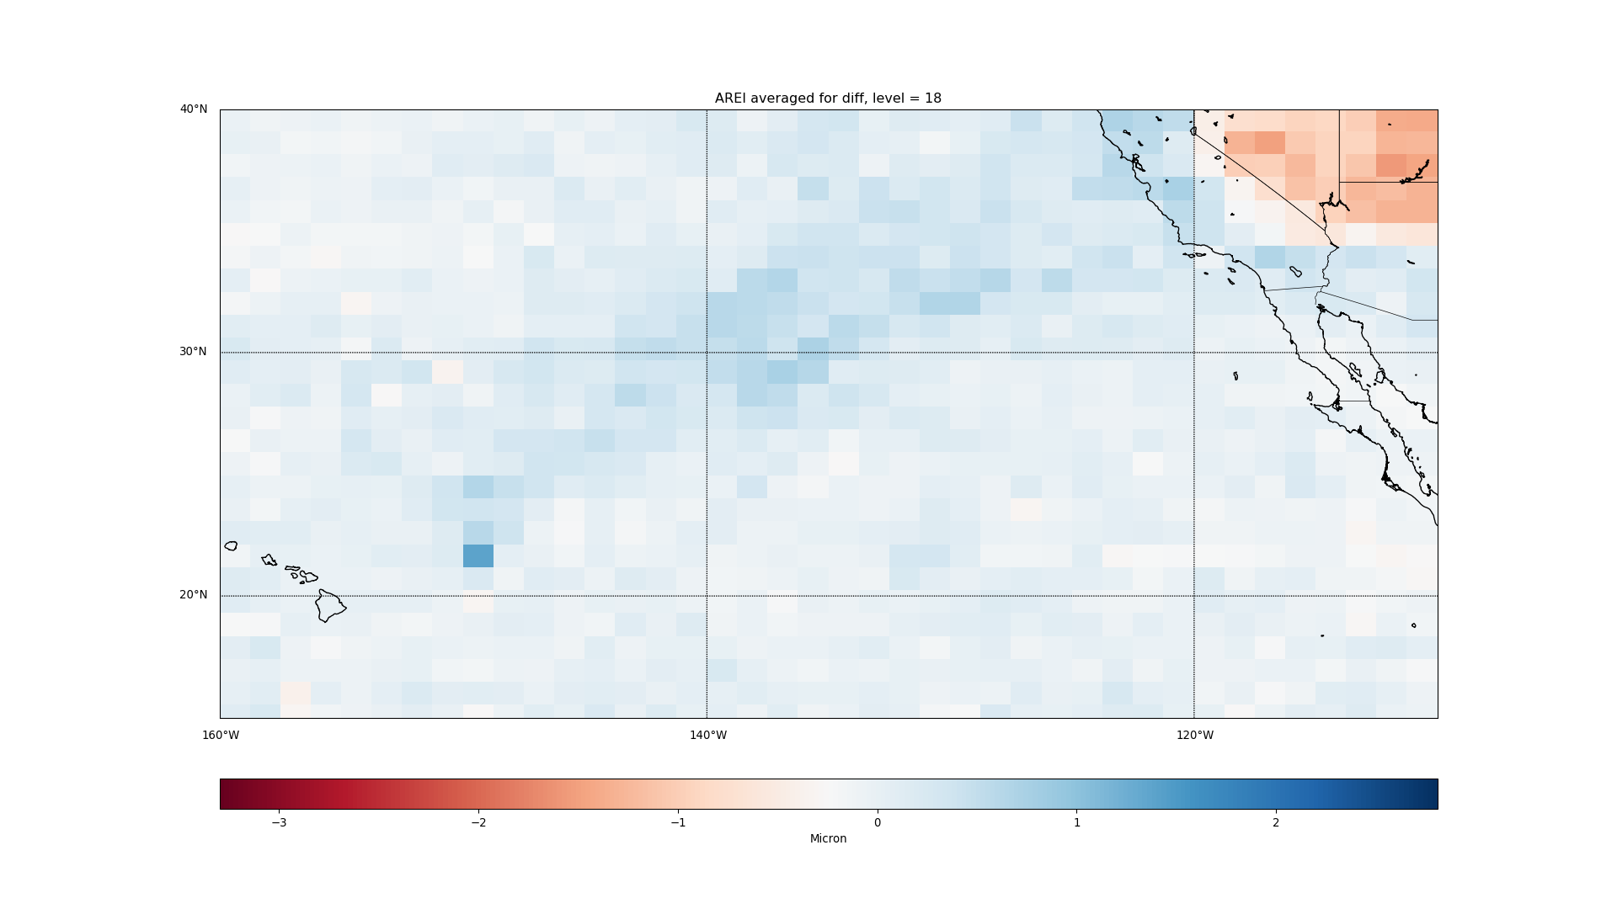

Slide 8
CLOUD: Hawaii to LA

Slide 9
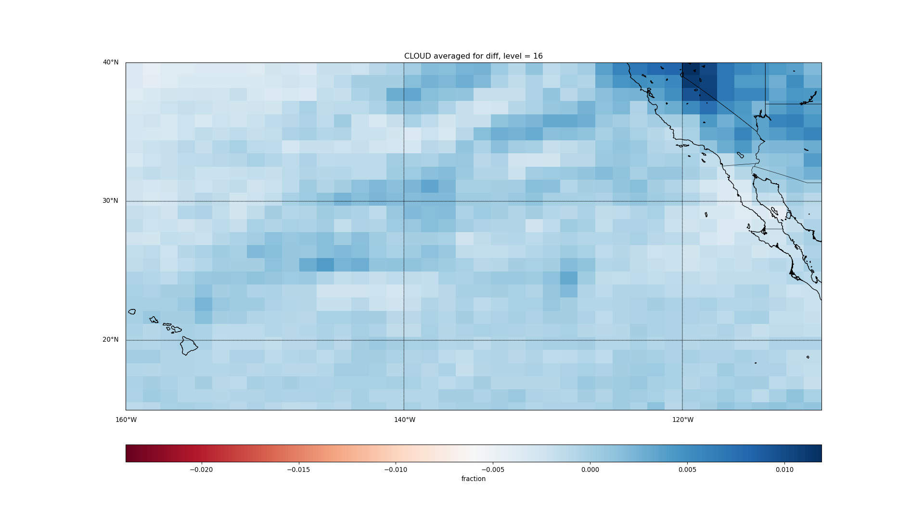

Slide 10
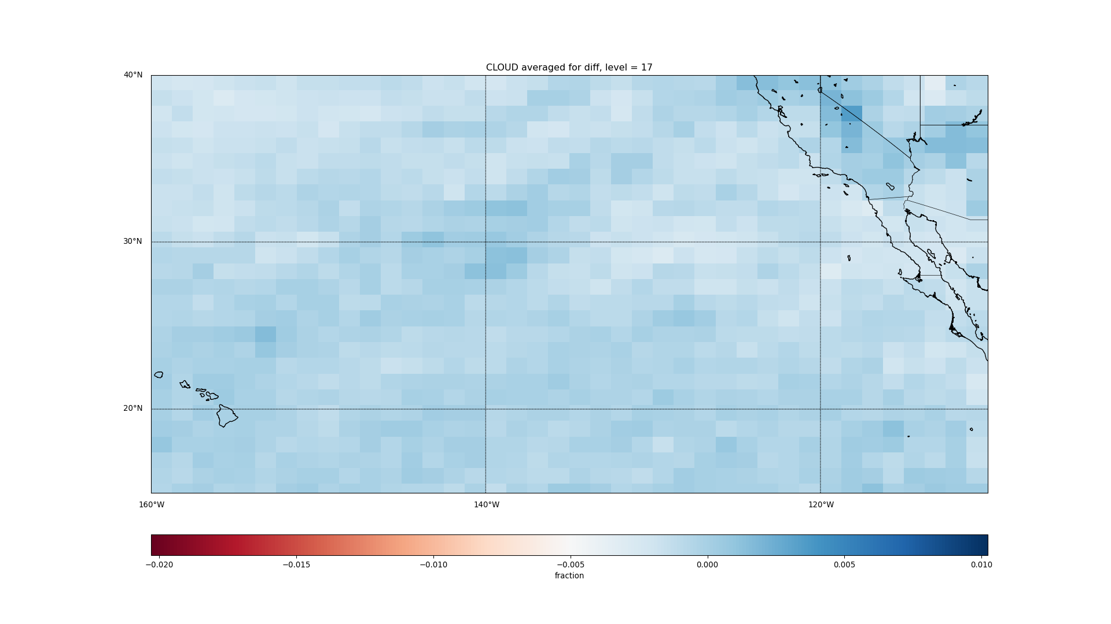

Slide 11
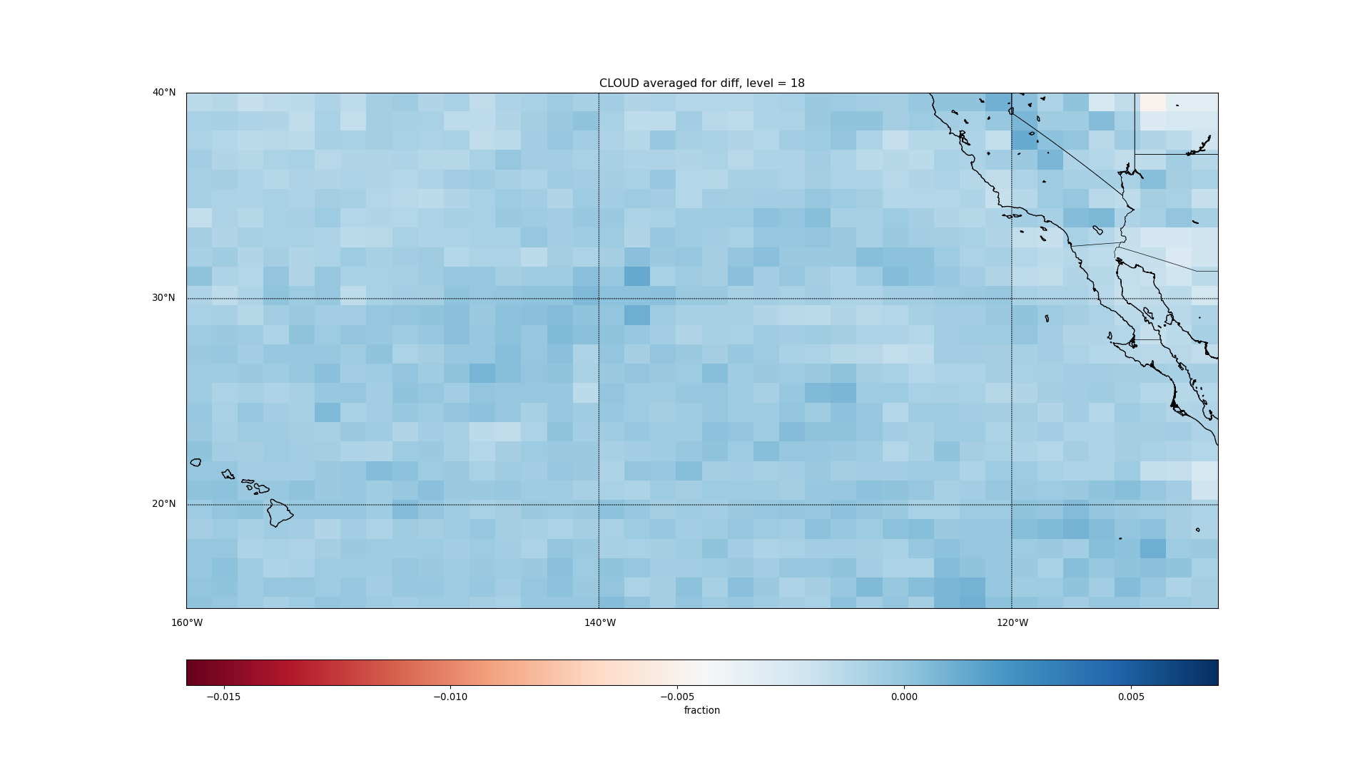

Slide 12
IWC: Hawaii to LA

Slide 13
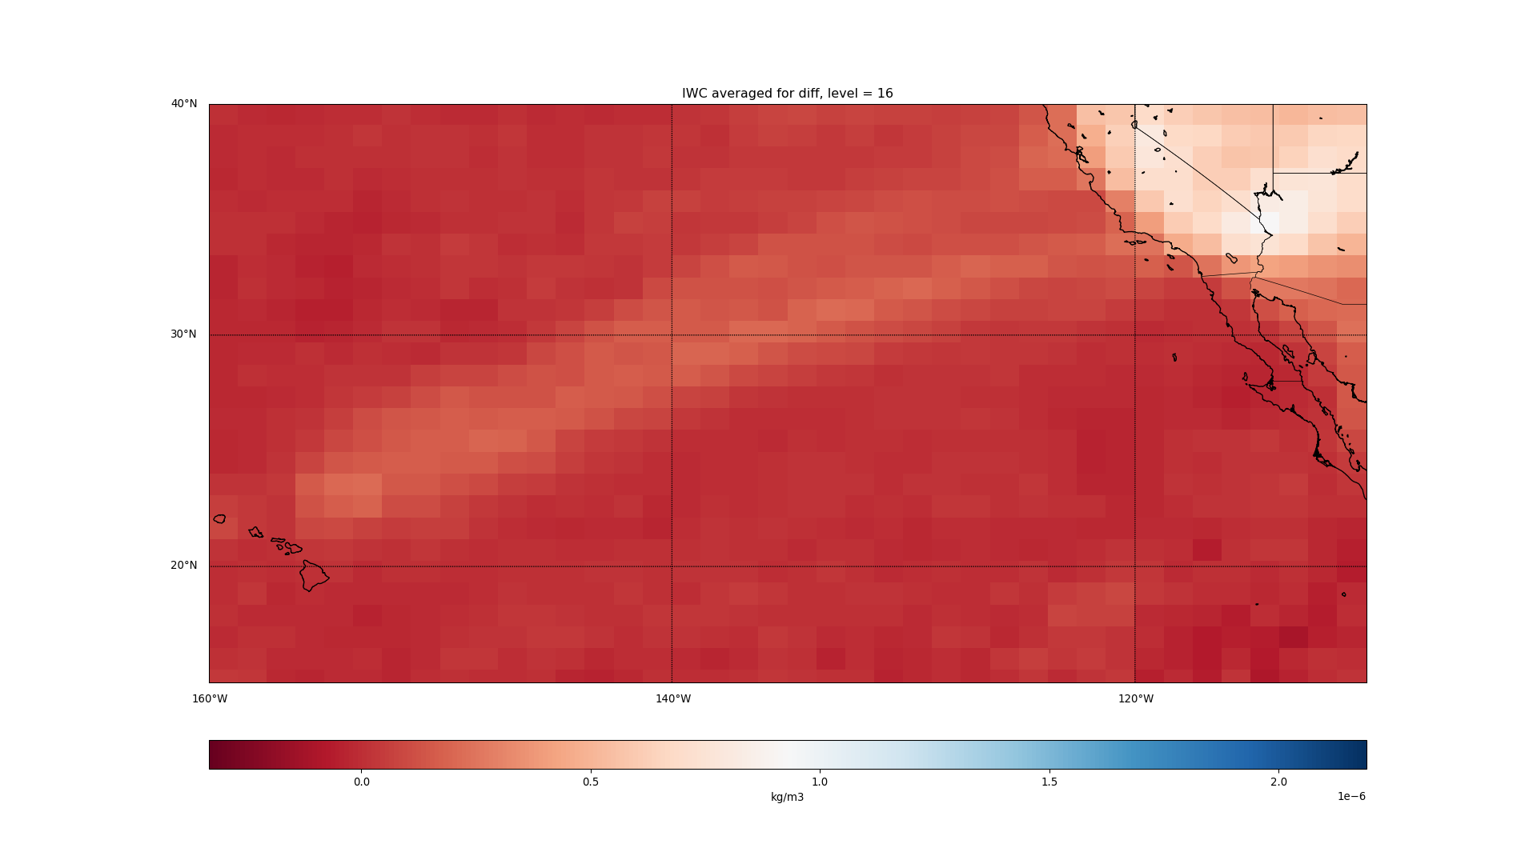

Slide 14
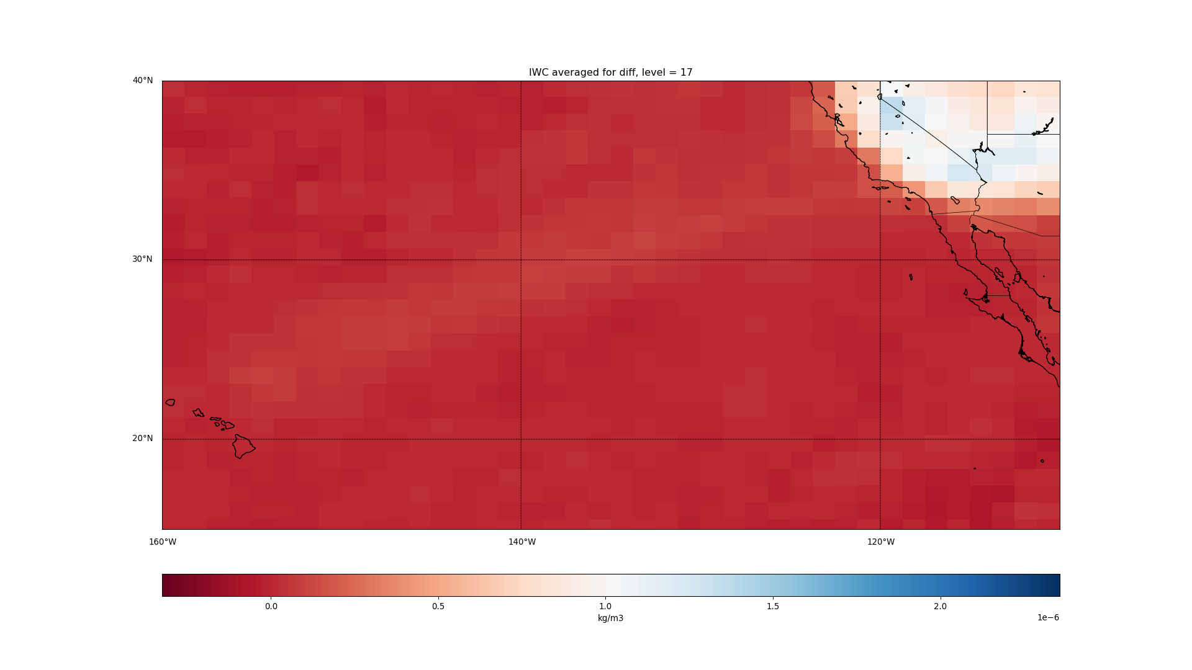

Slide 15
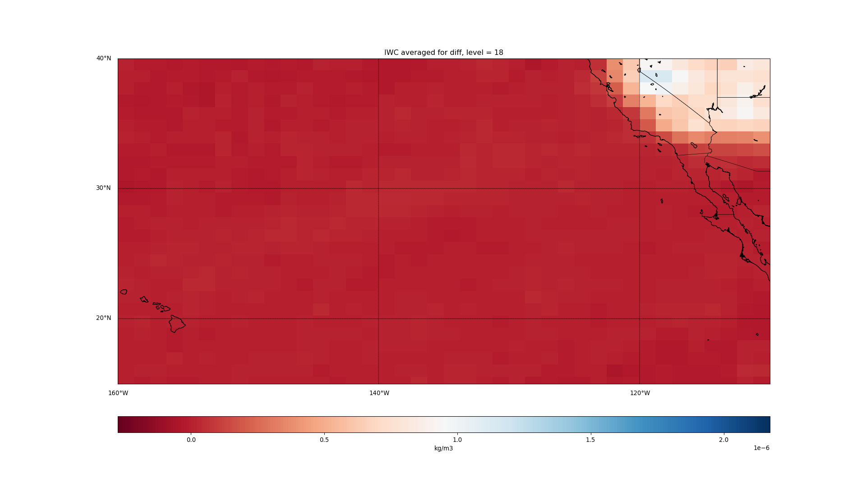

Slide 16
T: Hawaii to LA

Slide 17
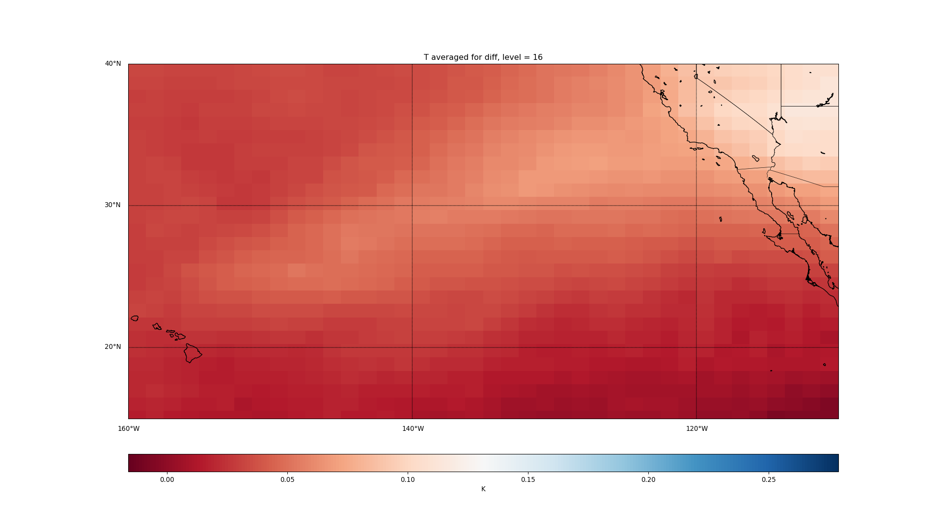

Slide 18
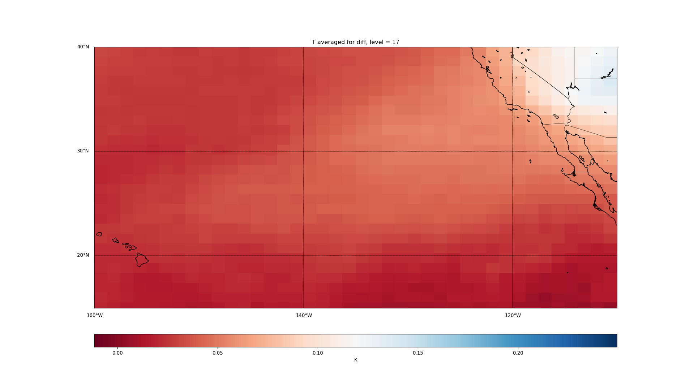

Slide 19
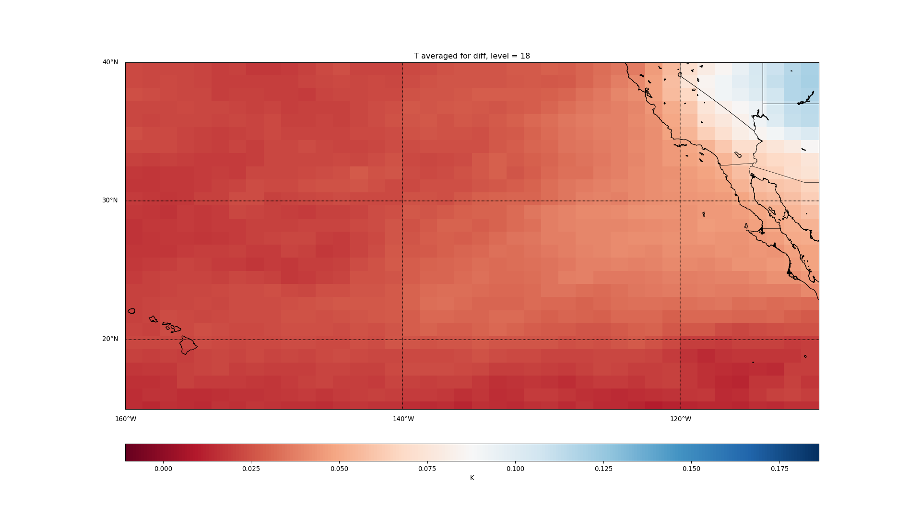

Slide 20
AREI: East US

Slide 21
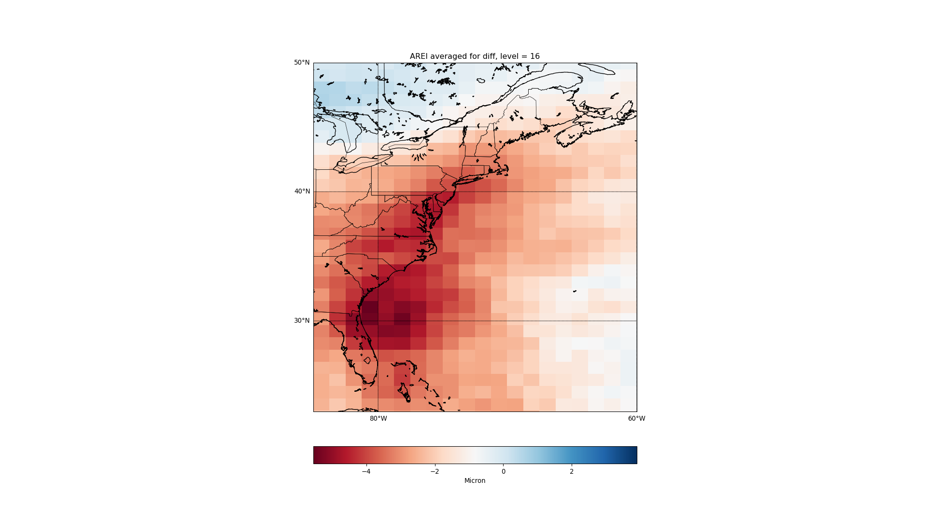

Slide 22
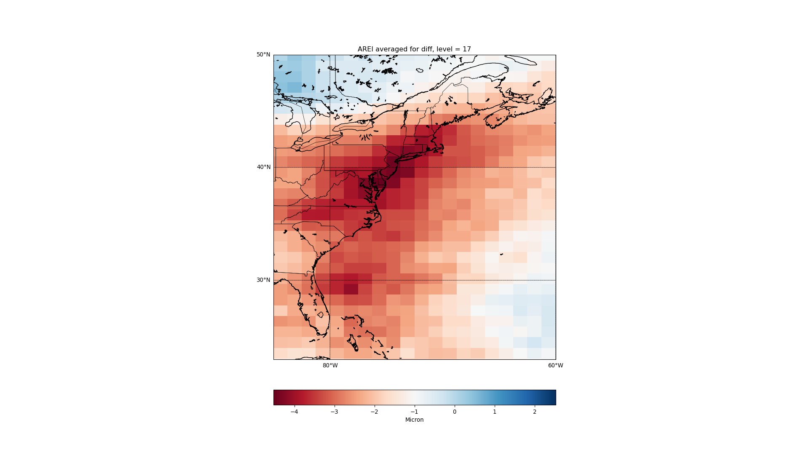

Slide 23
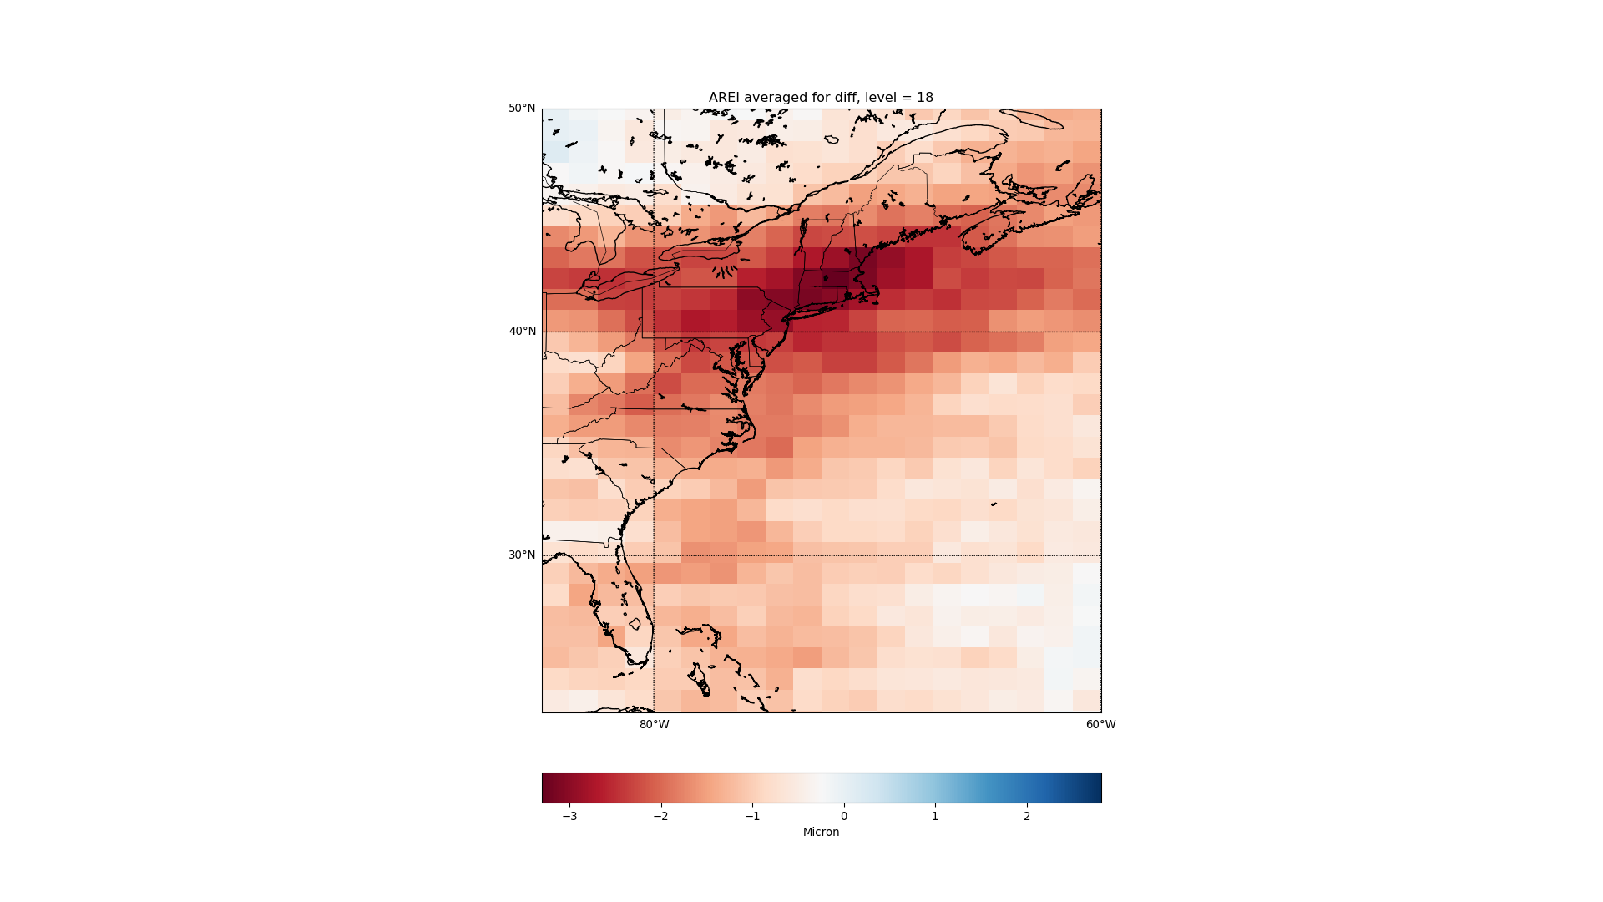

Slide 24
CLOUD: East US

Slide 25
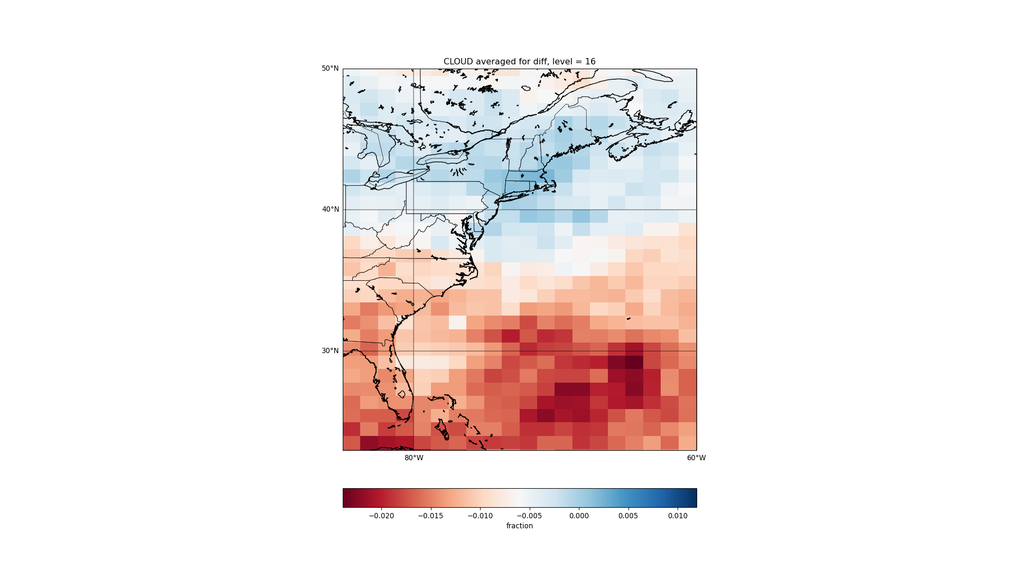

Slide 26
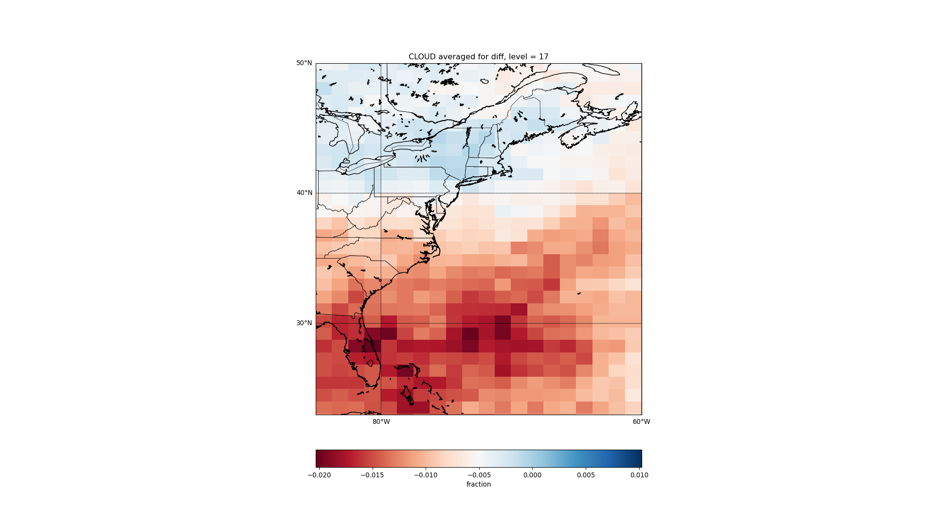

Slide 27
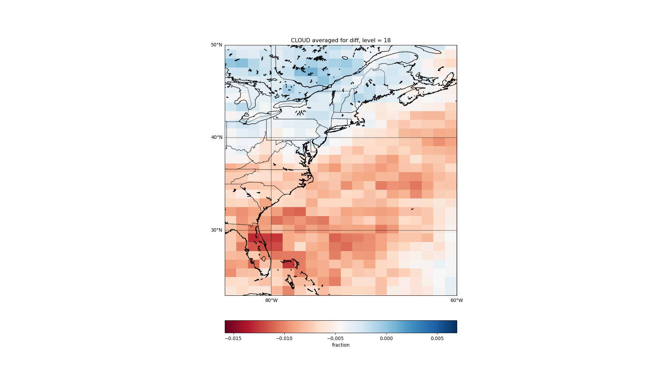

Slide 28
IWC: East US

Slide 29
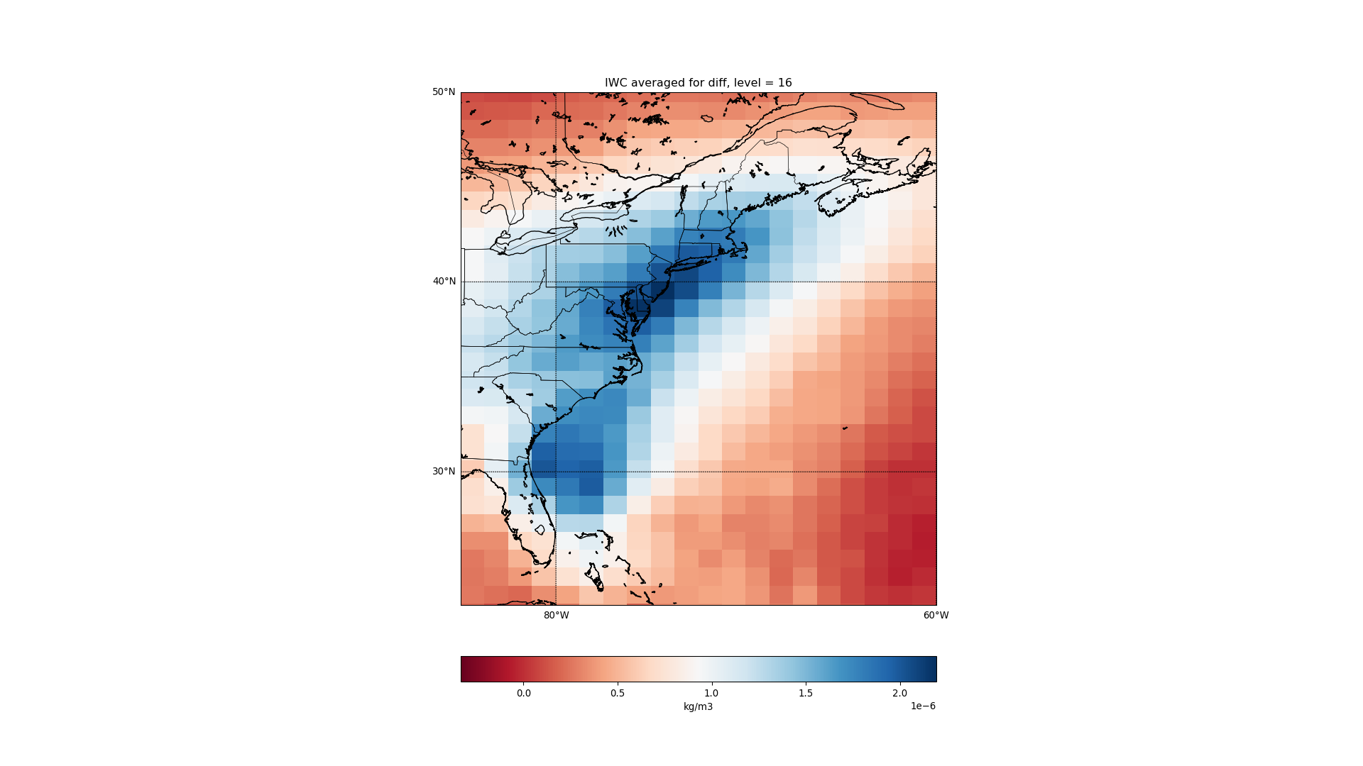

Slide 30
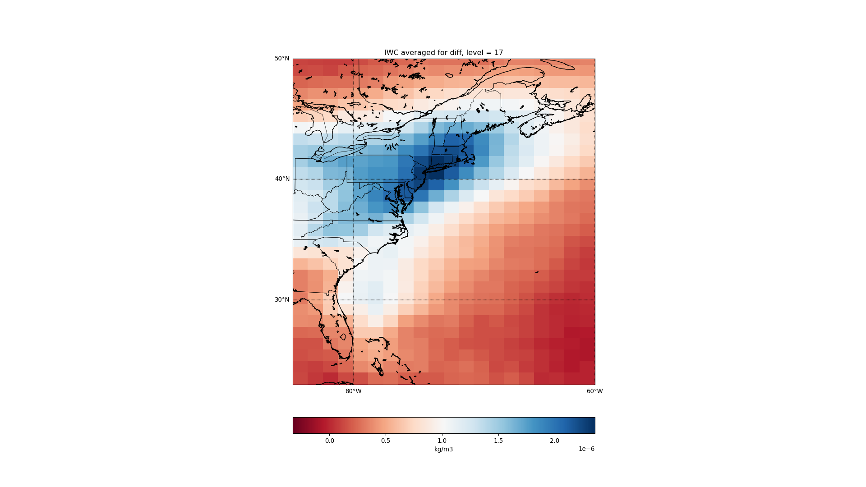

Slide 31
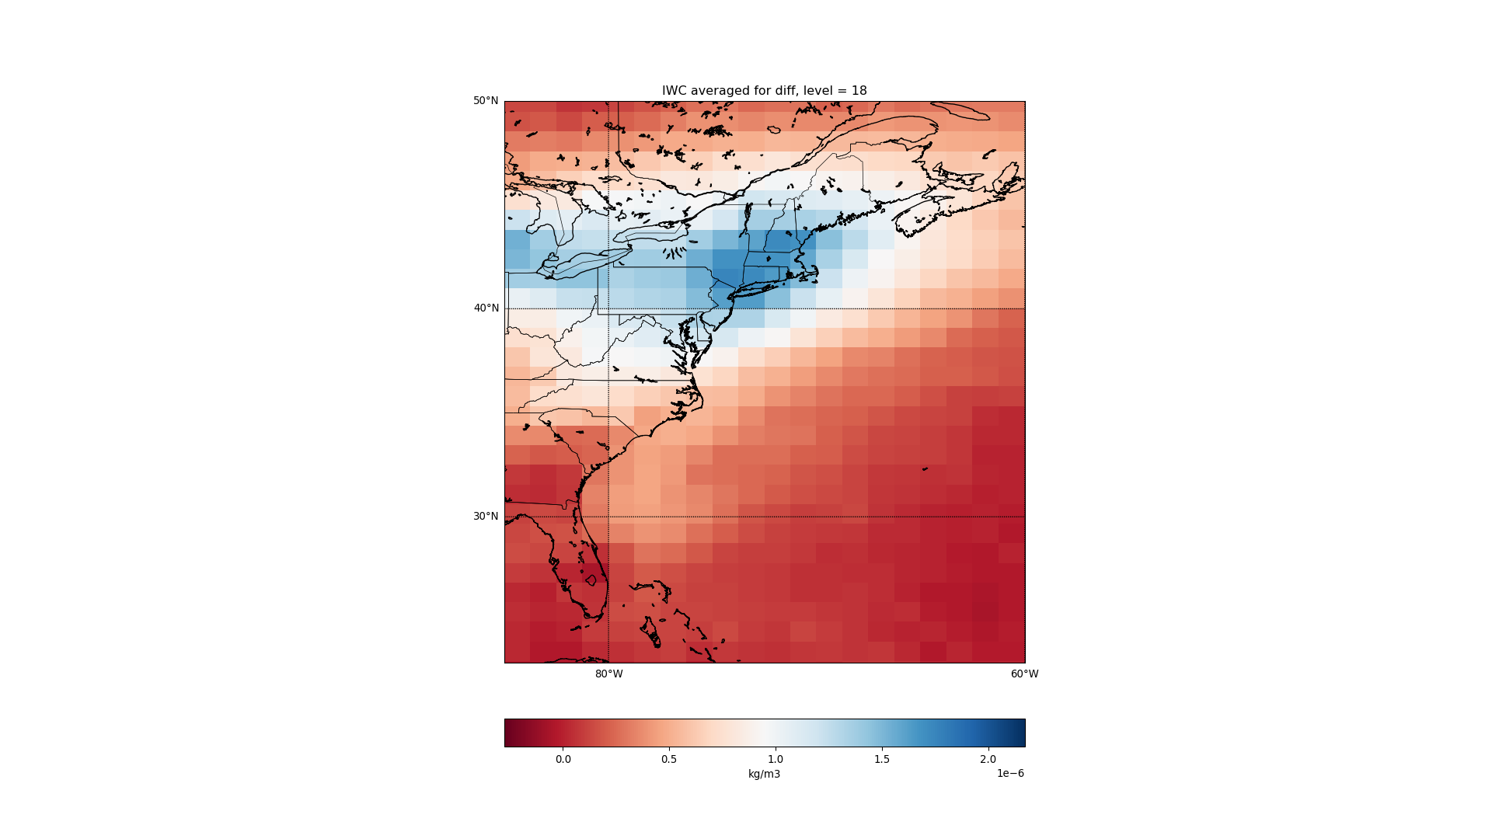

Slide 32
T: East US

Slide 33
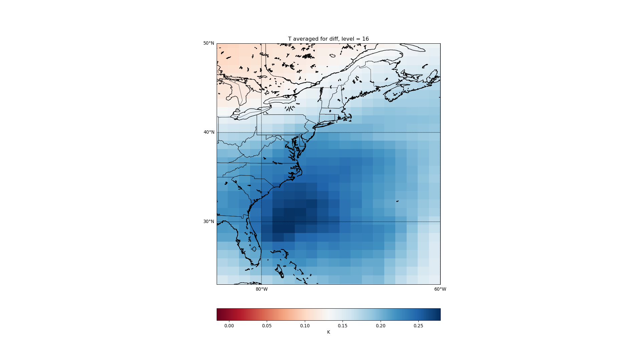

Slide 34
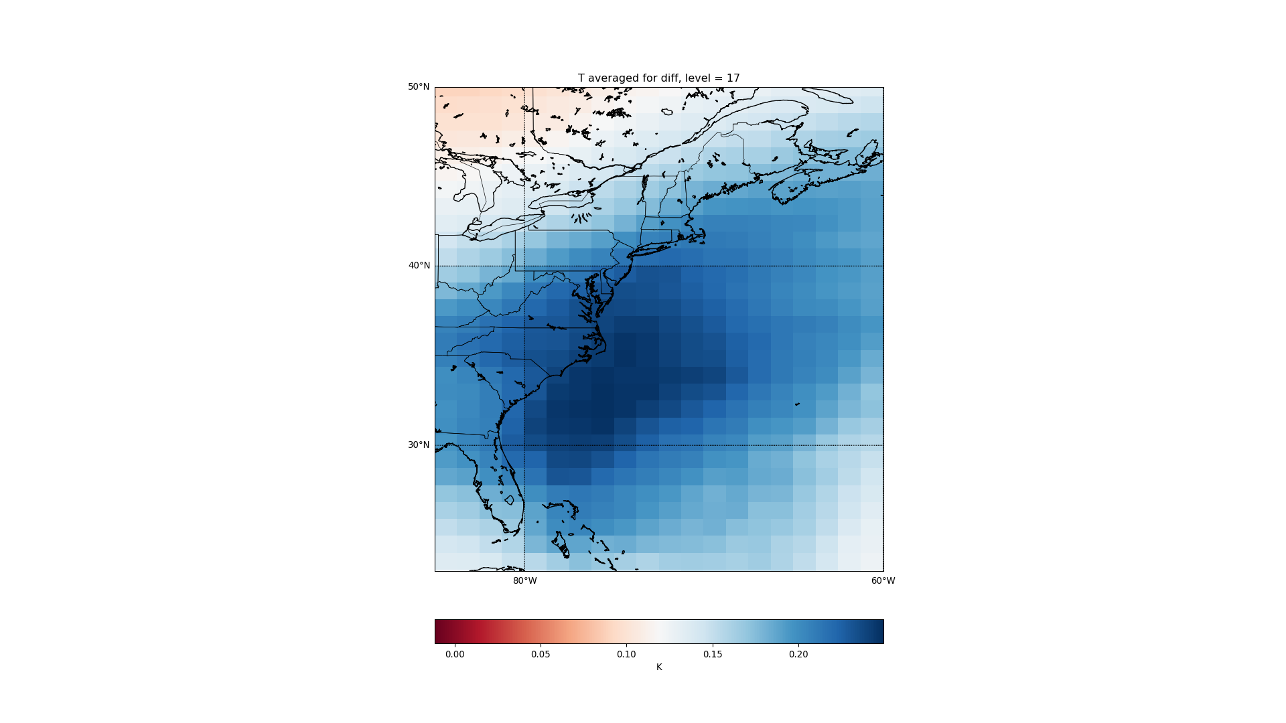

Slide 35
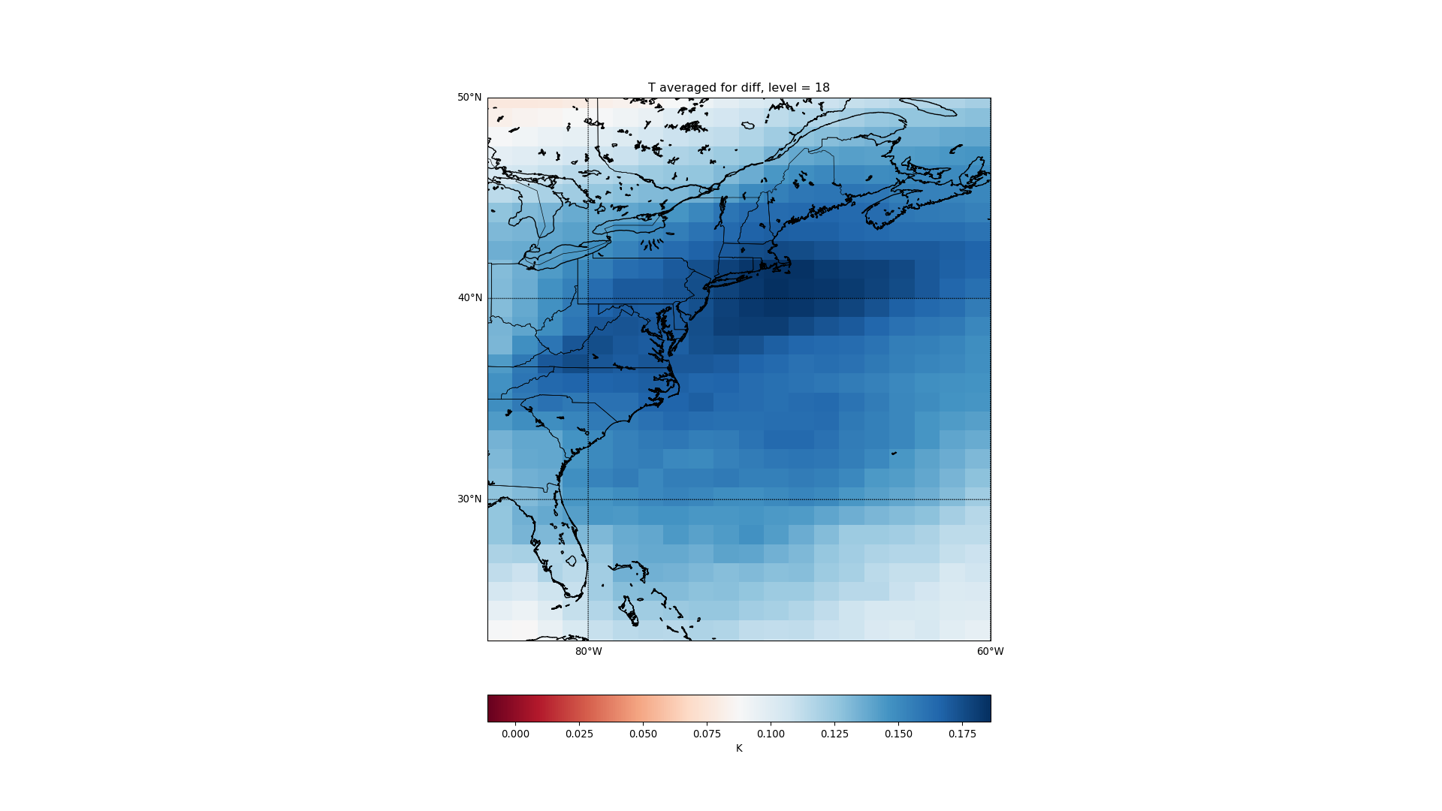

Slide 36
AREI: West Europe

Slide 37
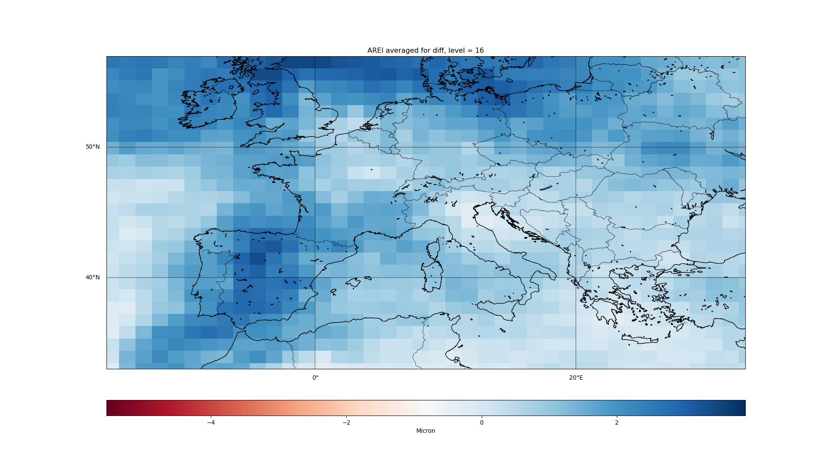

Slide 38
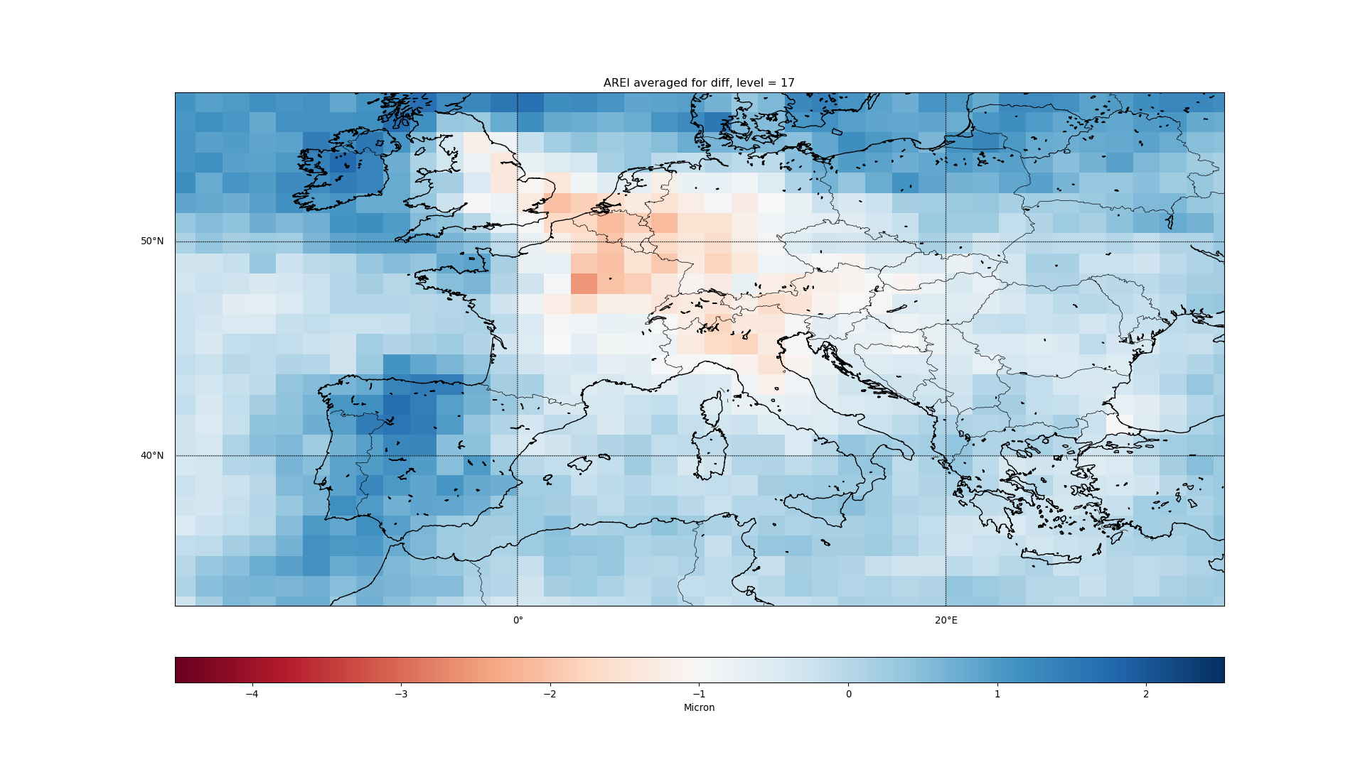

Slide 39
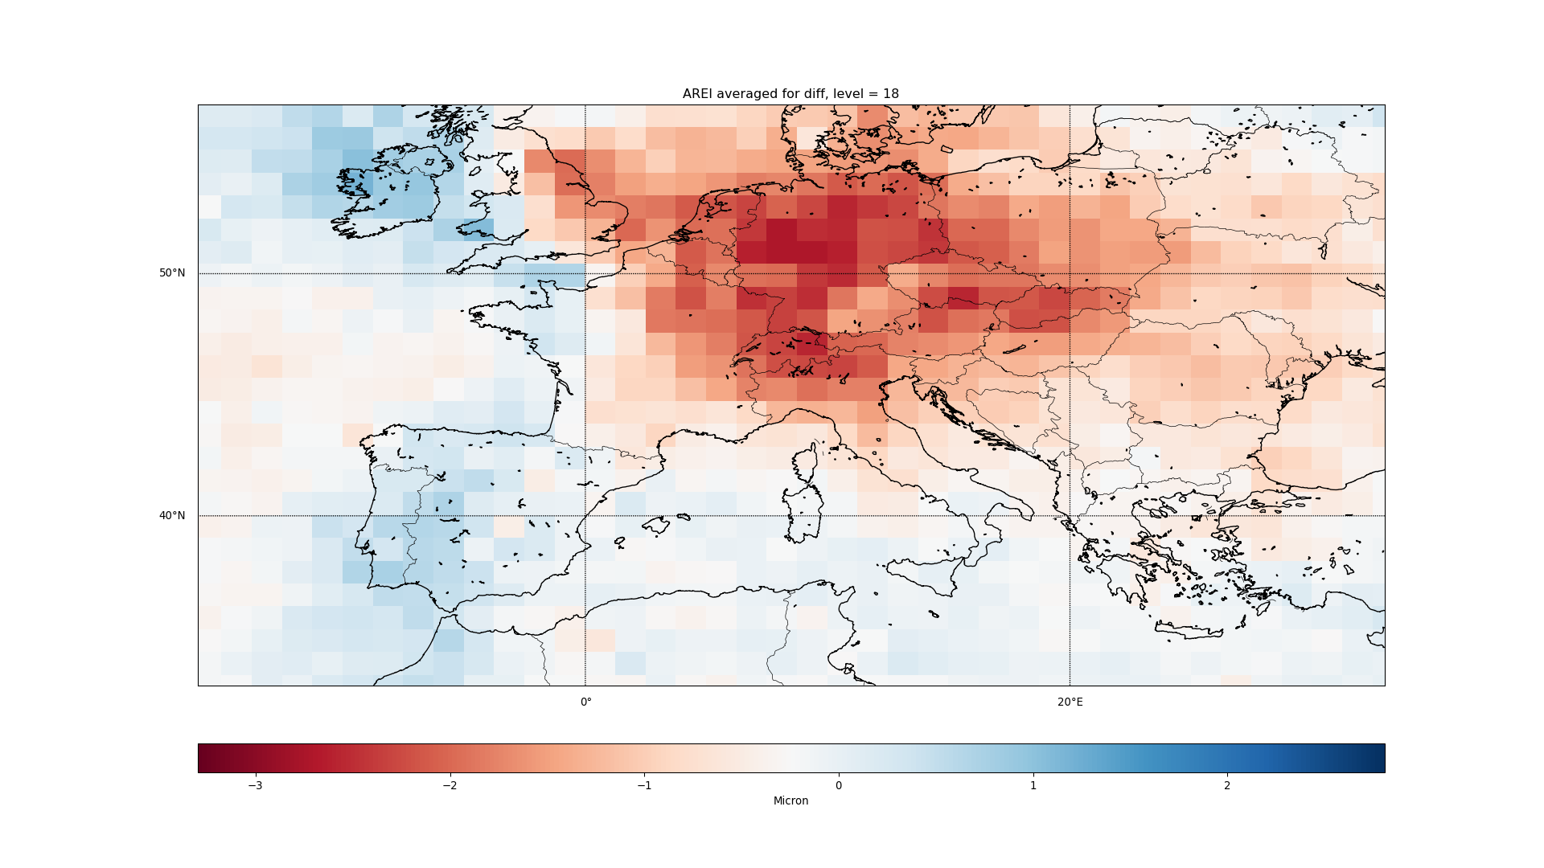

Slide 40
CLOUD: West Europe

Slide 41
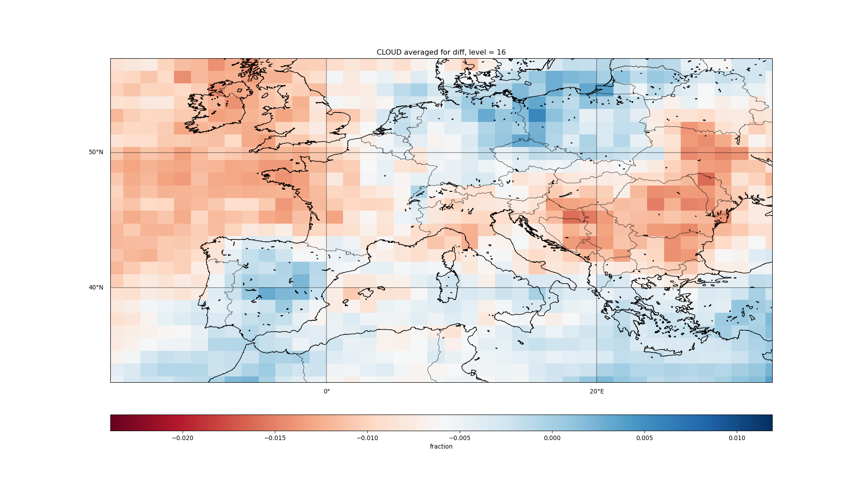

Slide 42
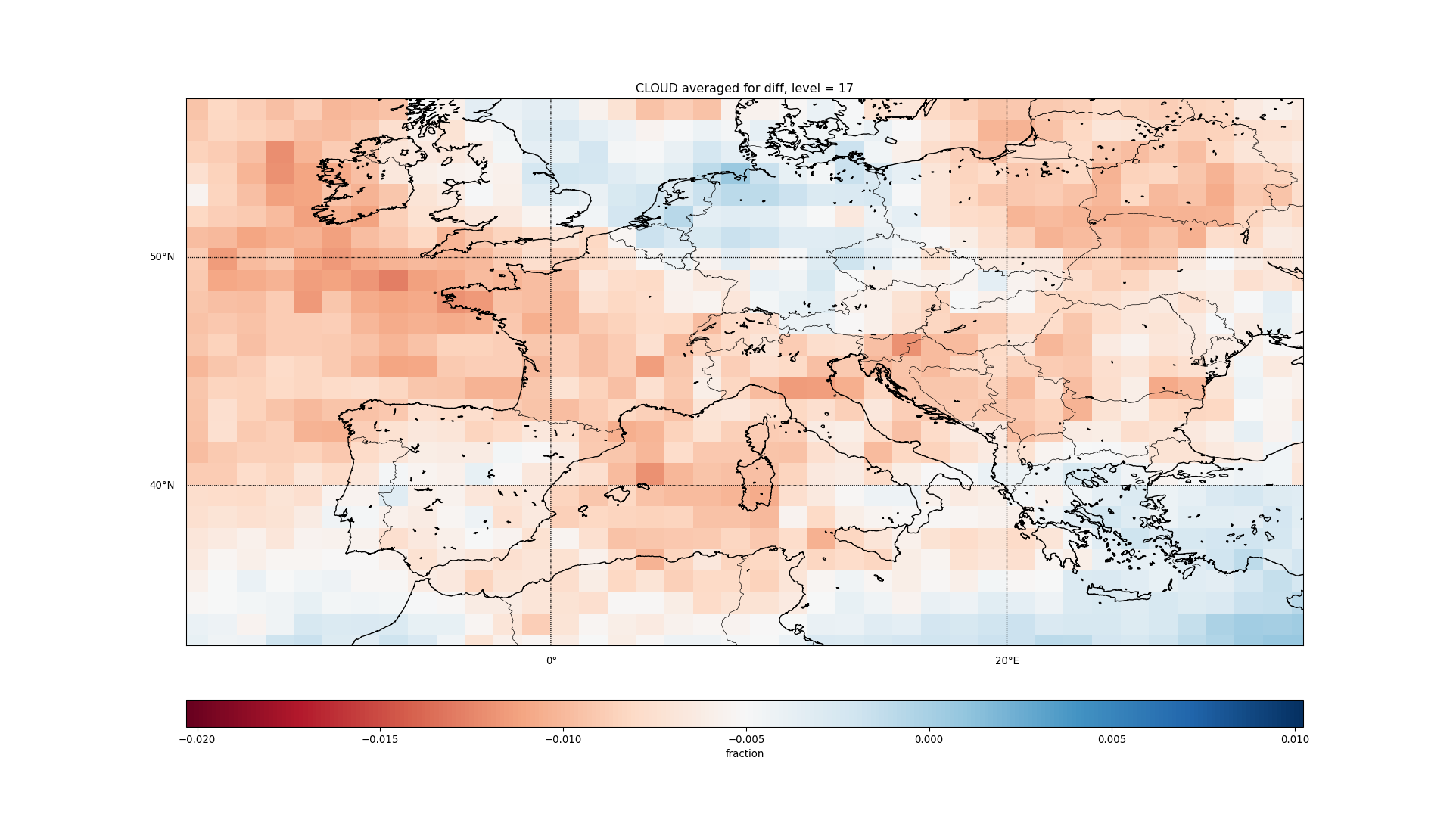

Slide 43
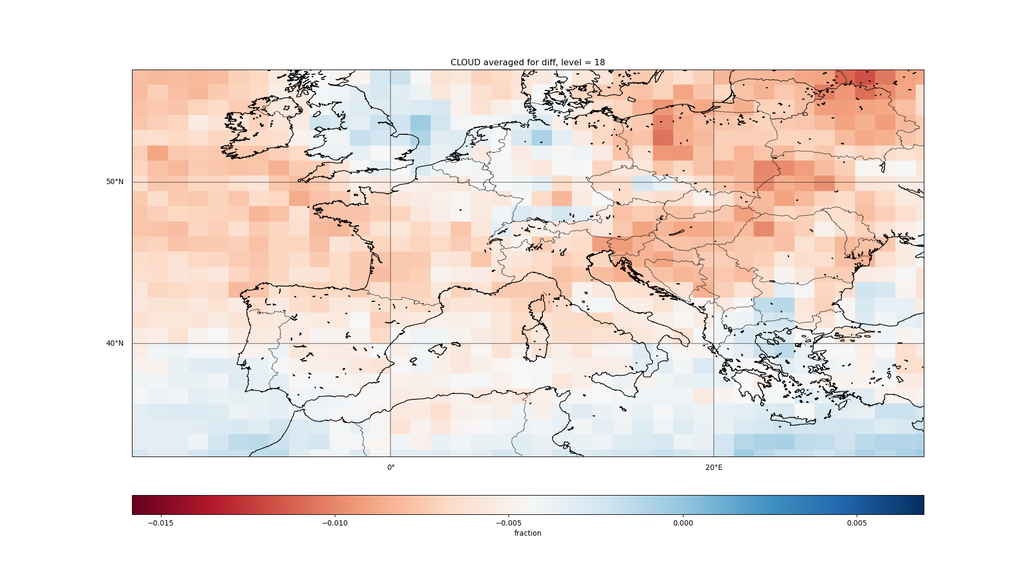

Slide 44
IWC: West Europe

Slide 45
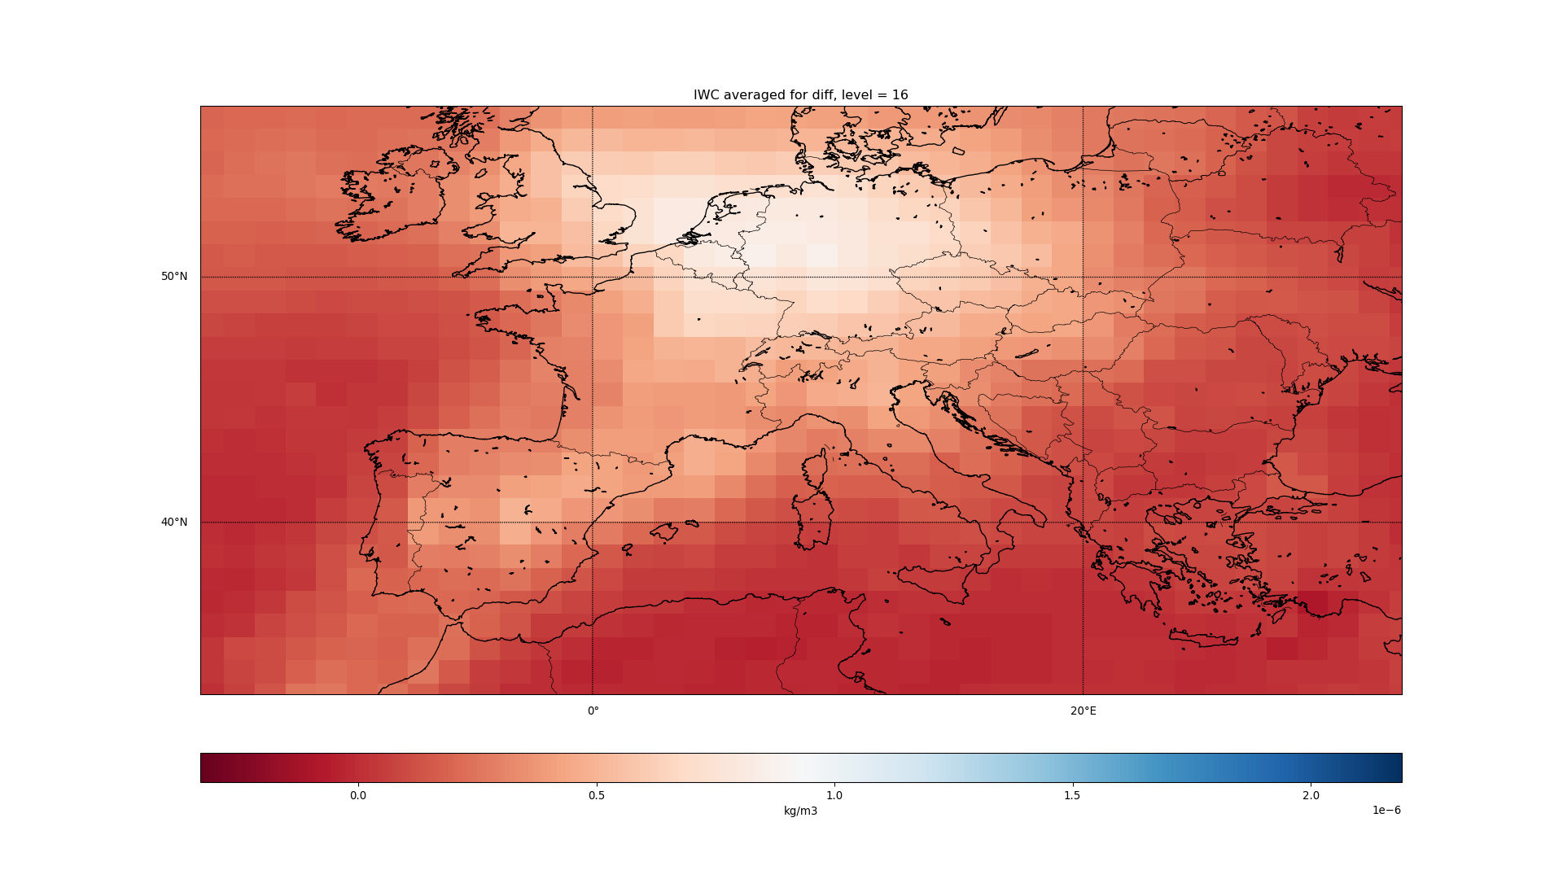

Slide 46
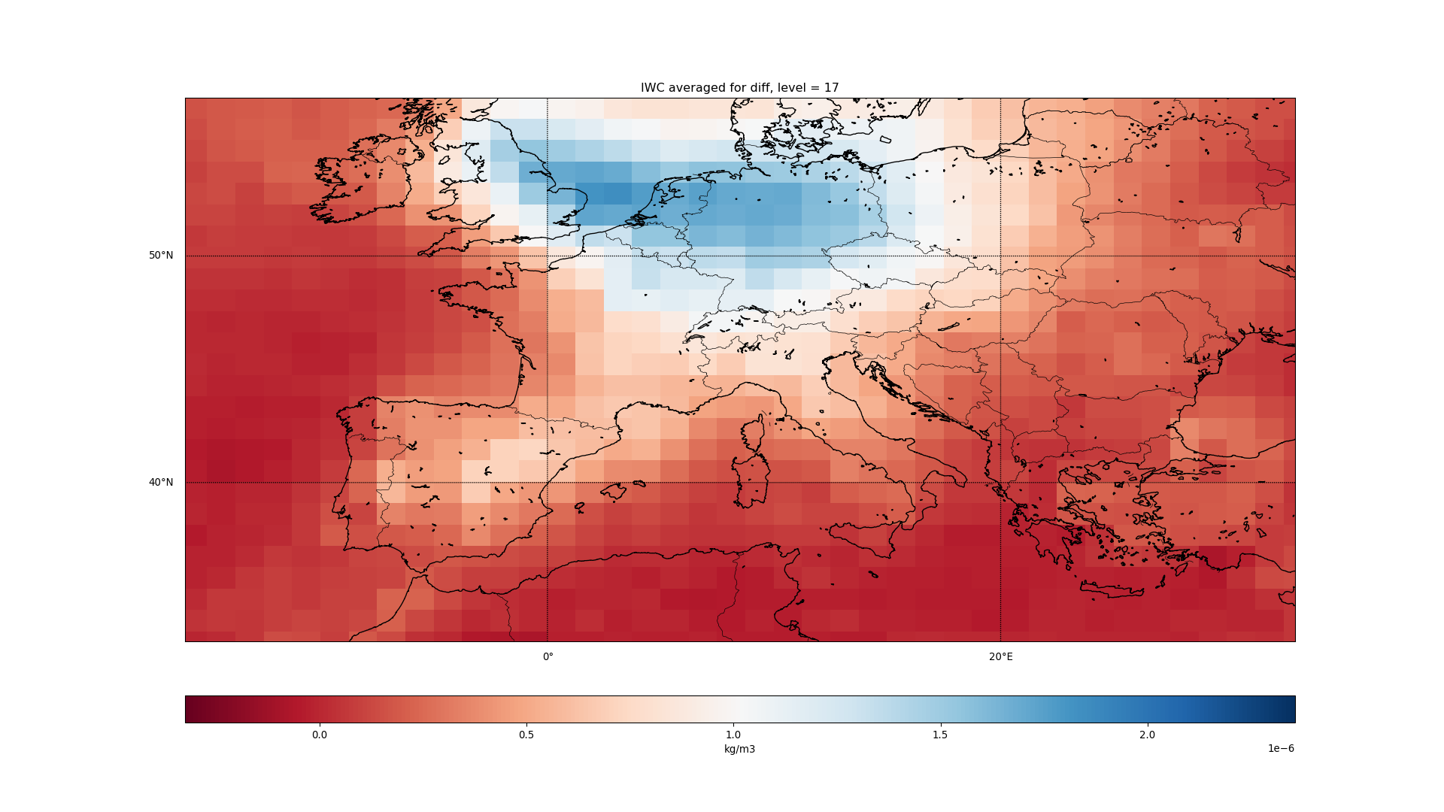

Slide 47
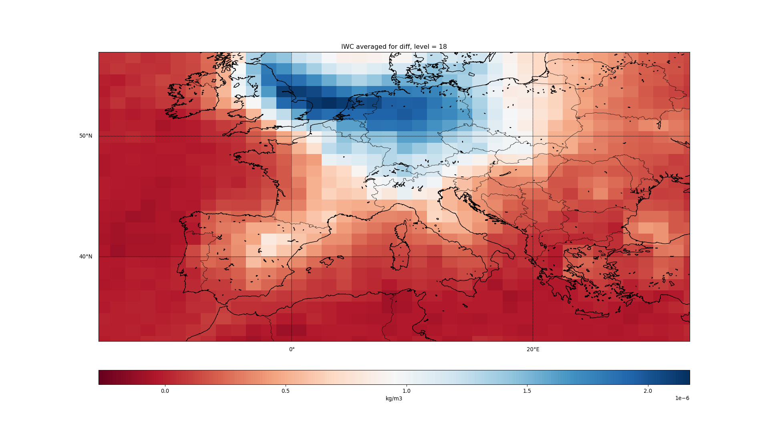

Slide 48
T: West Europe

Slide 49
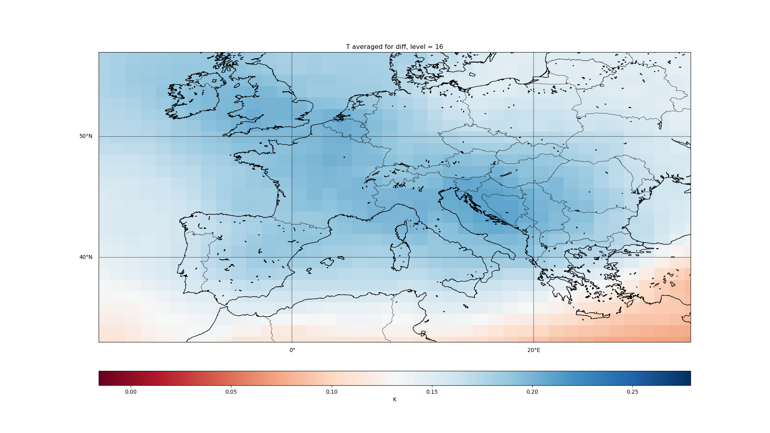

Slide 50
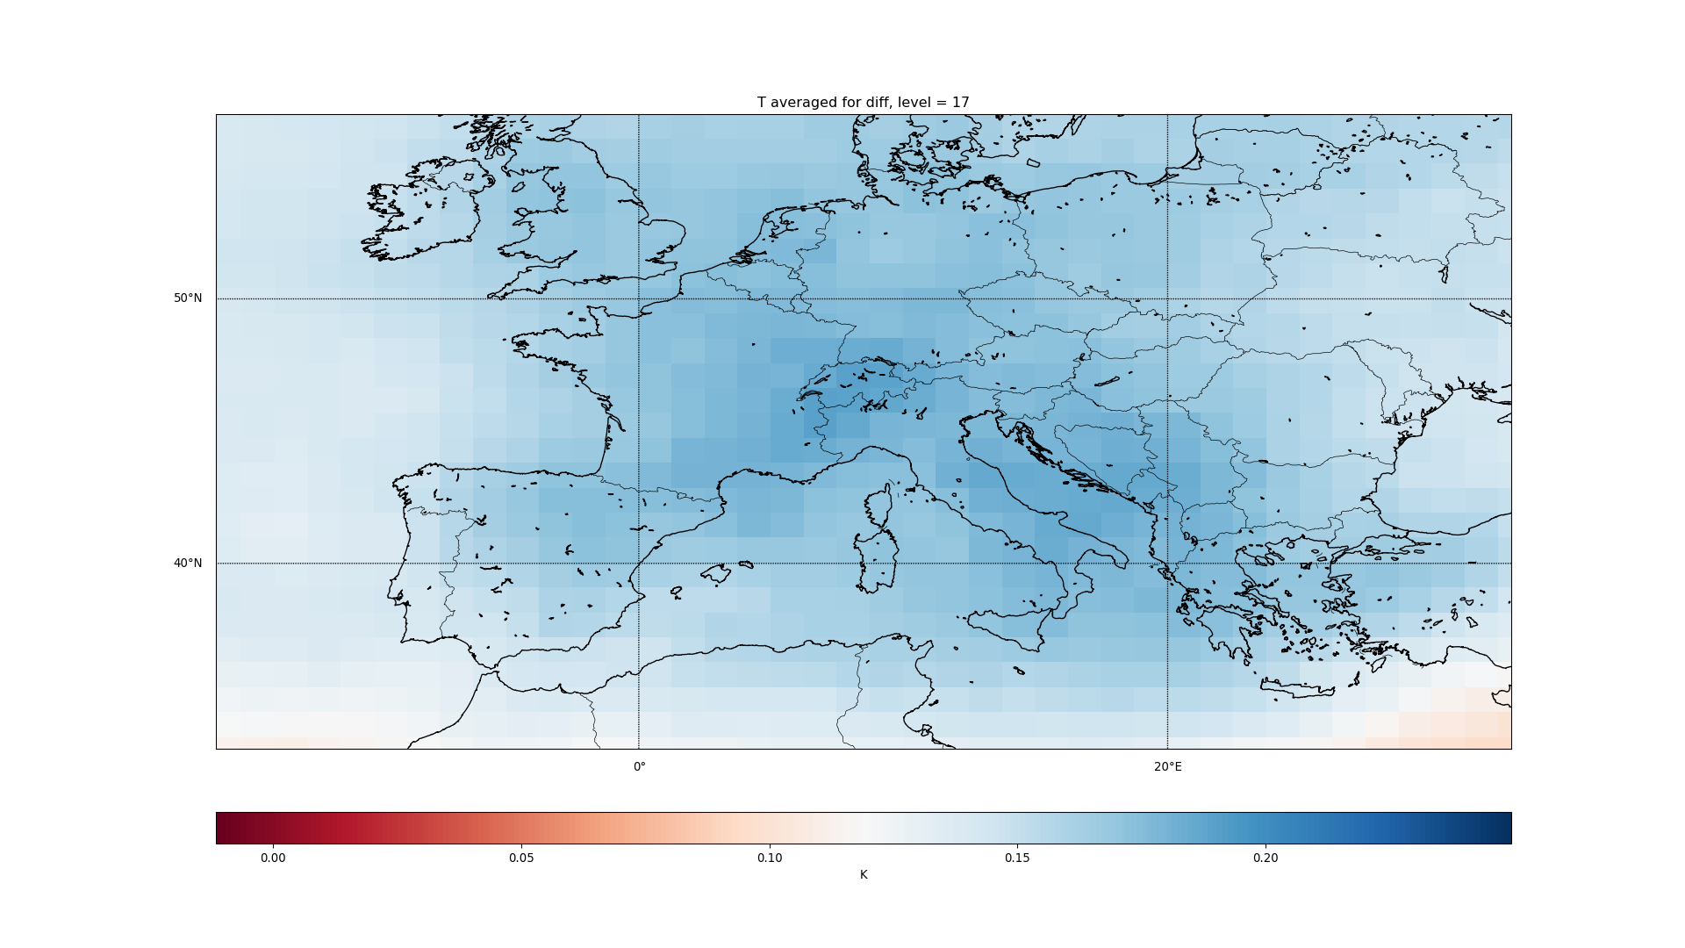

Slide 51
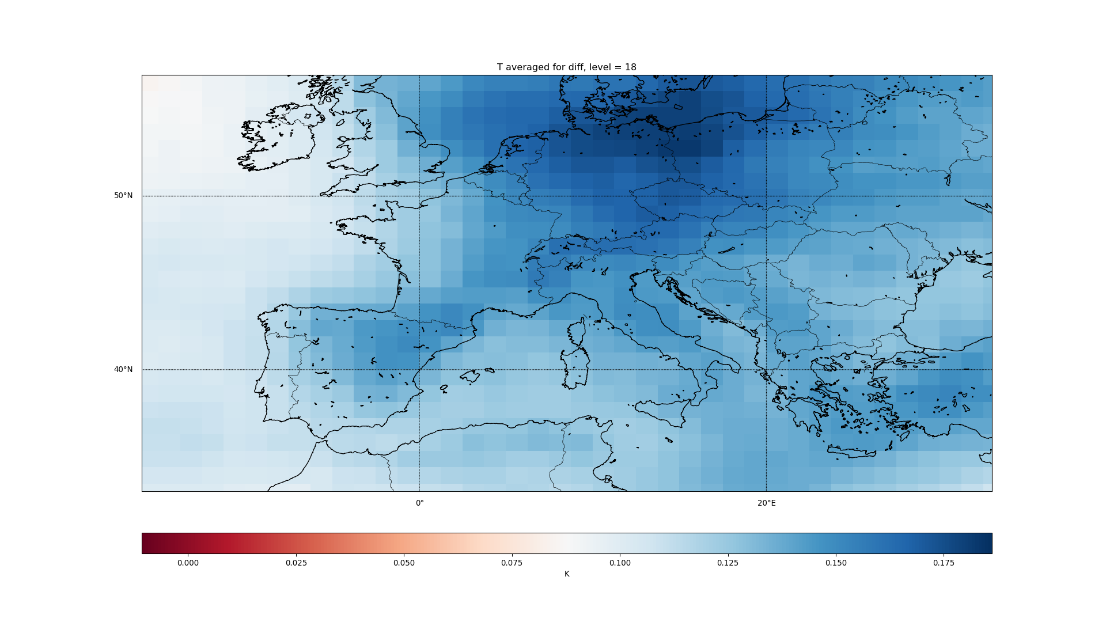

Slide 52
AREI: East Asia

Slide 53
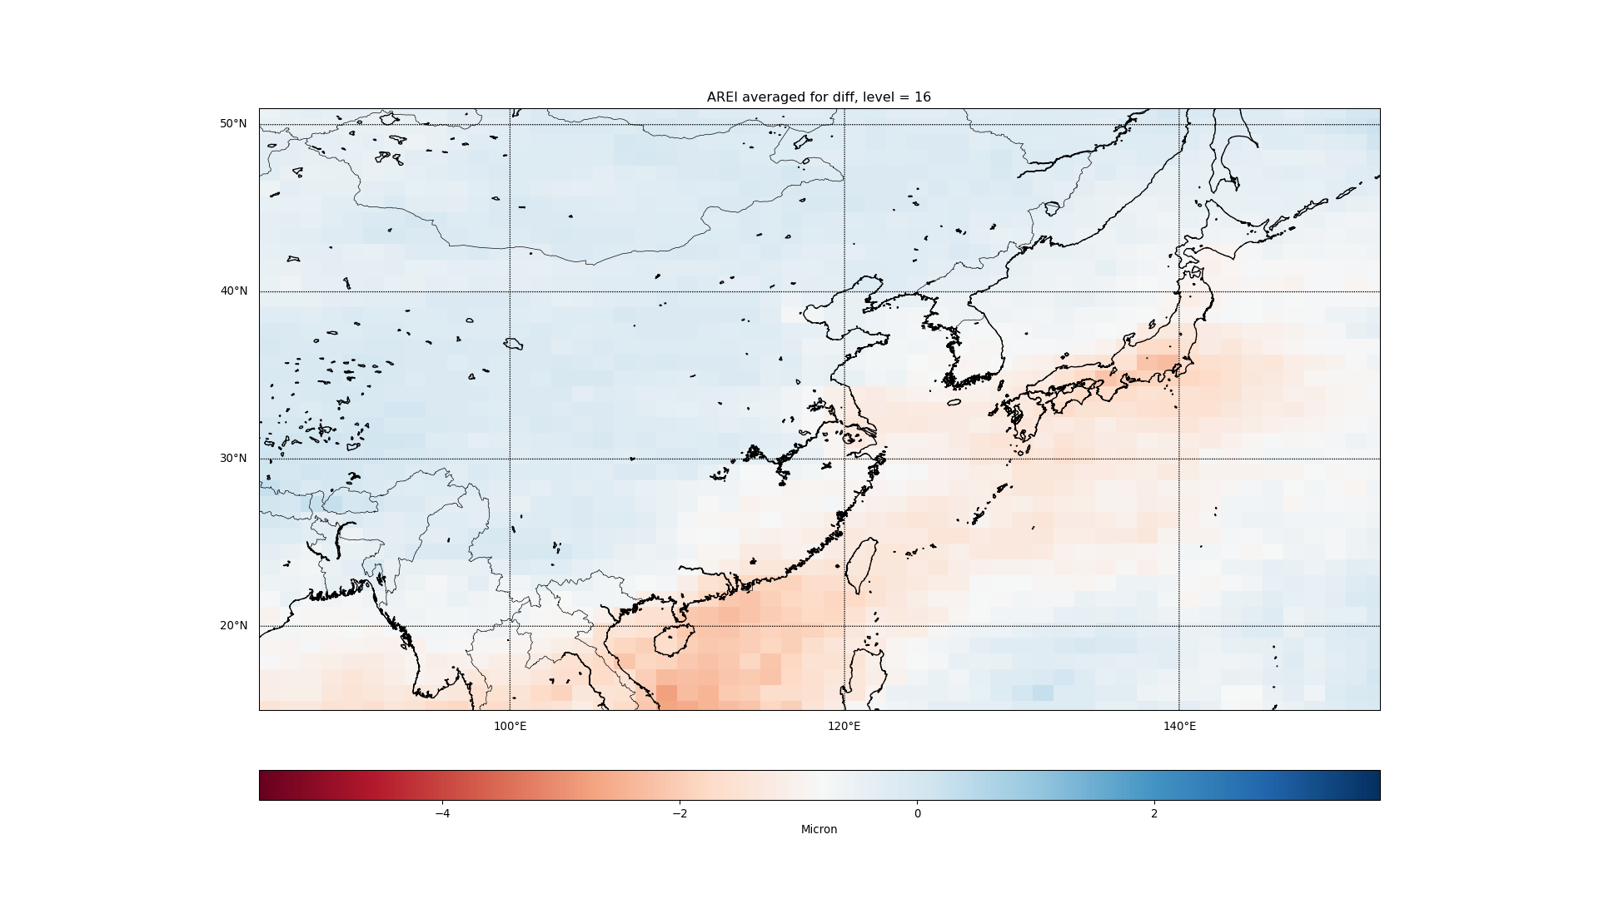

Slide 54
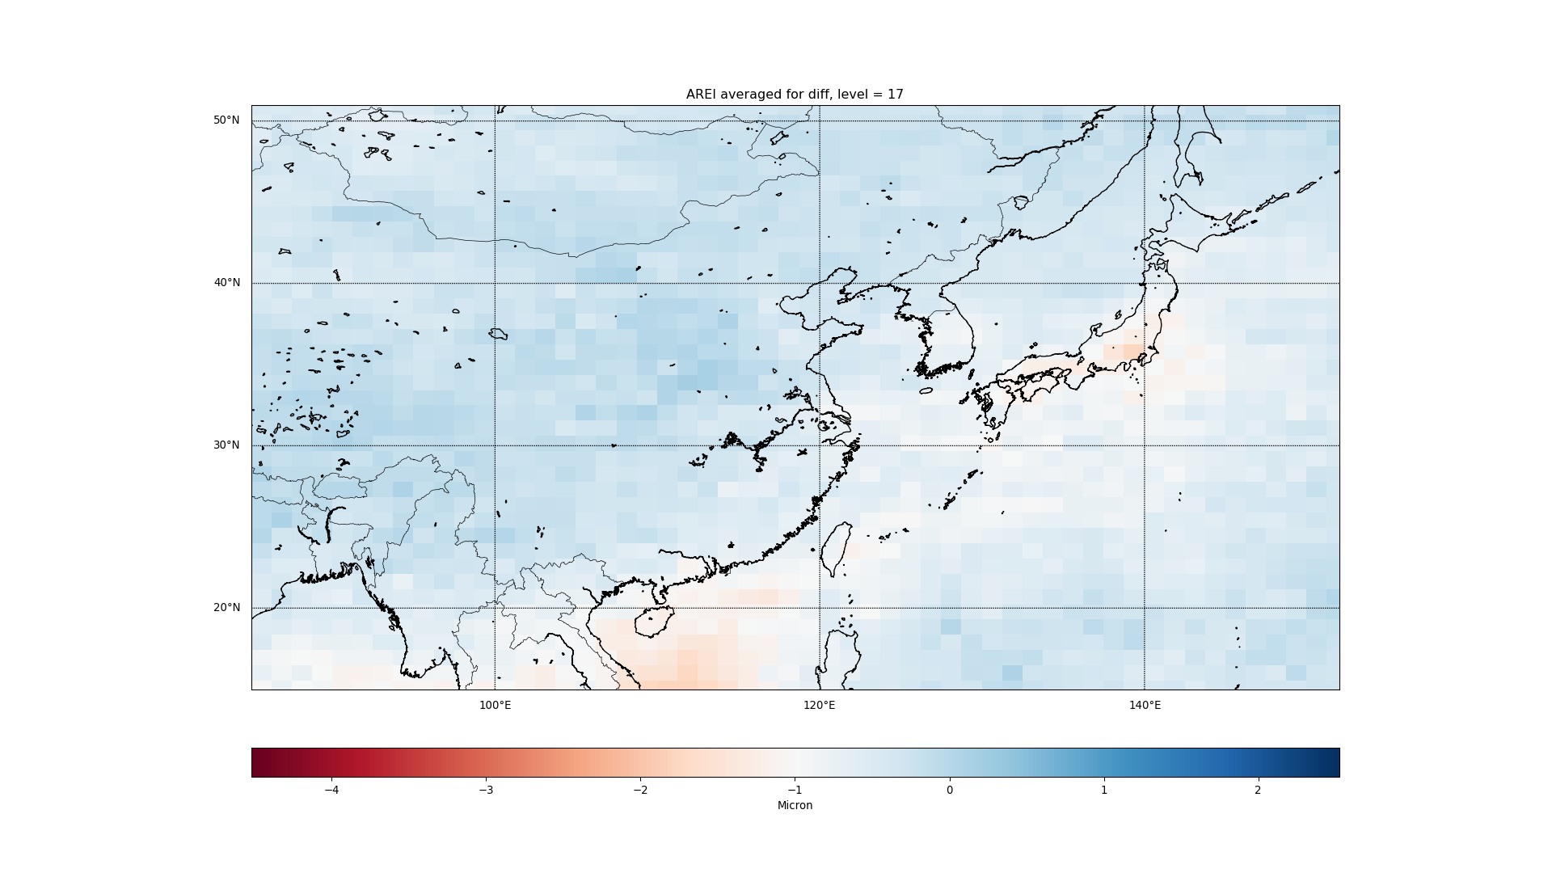

Slide 55
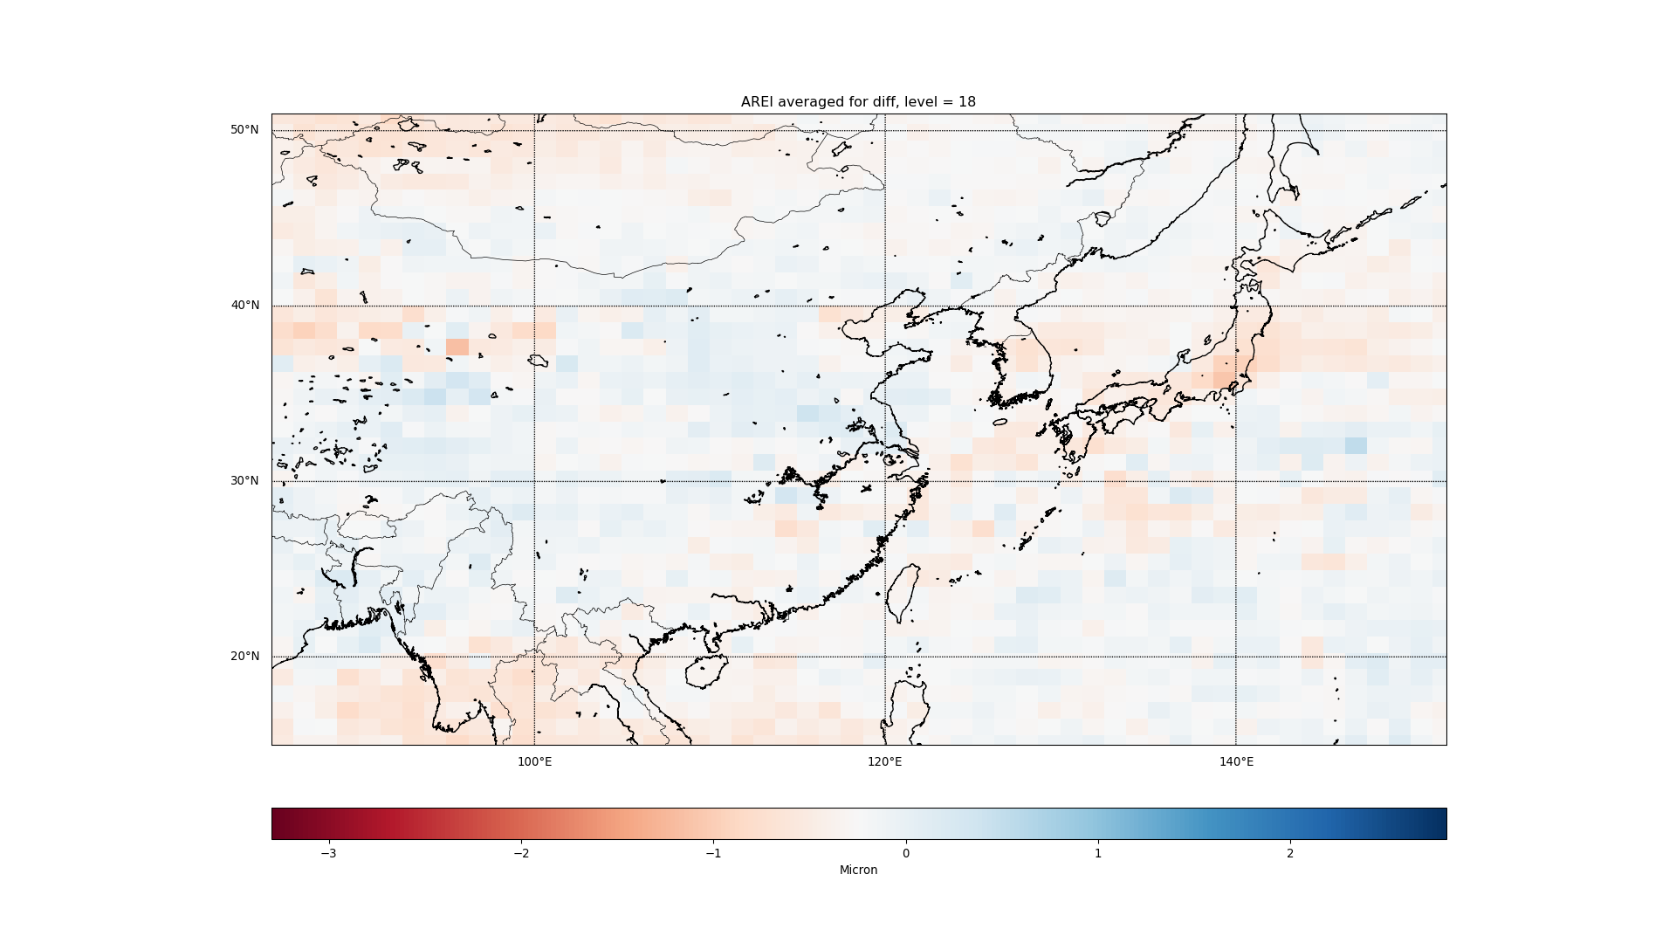

Slide 56
CLOUD: East Asia

Slide 57
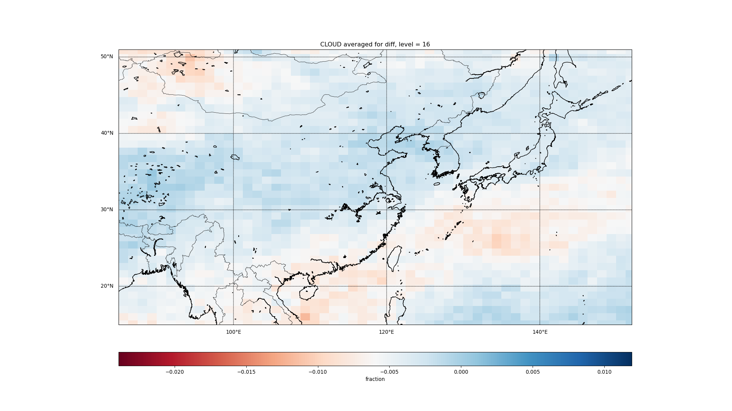

Slide 58
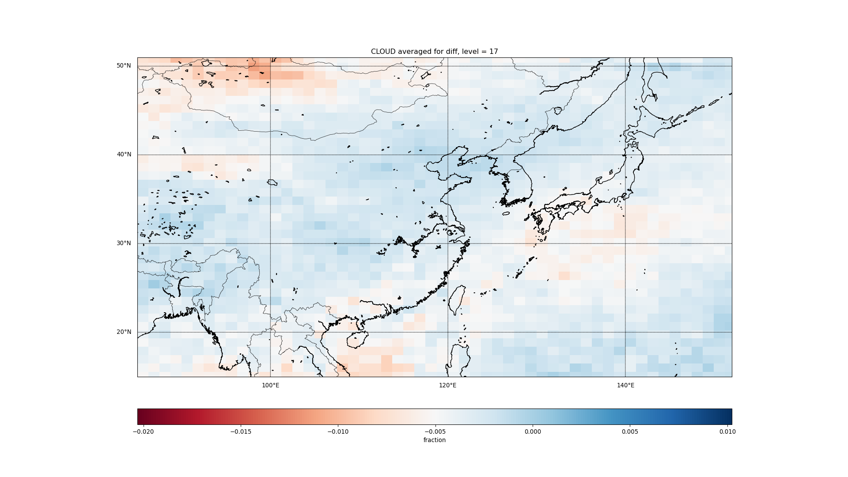

Slide 59
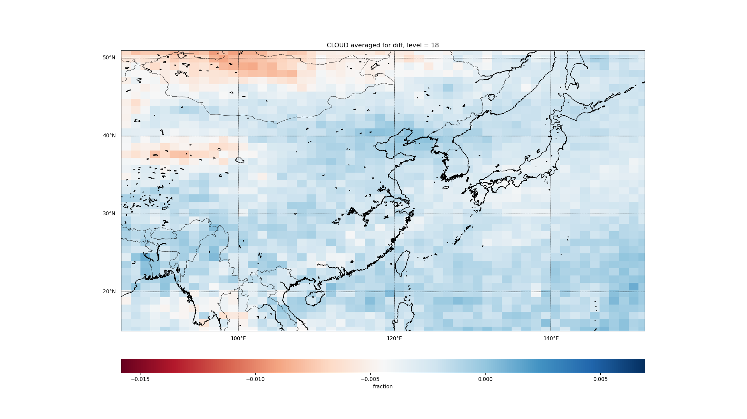

Slide 60
IWC: East Asia

Slide 61
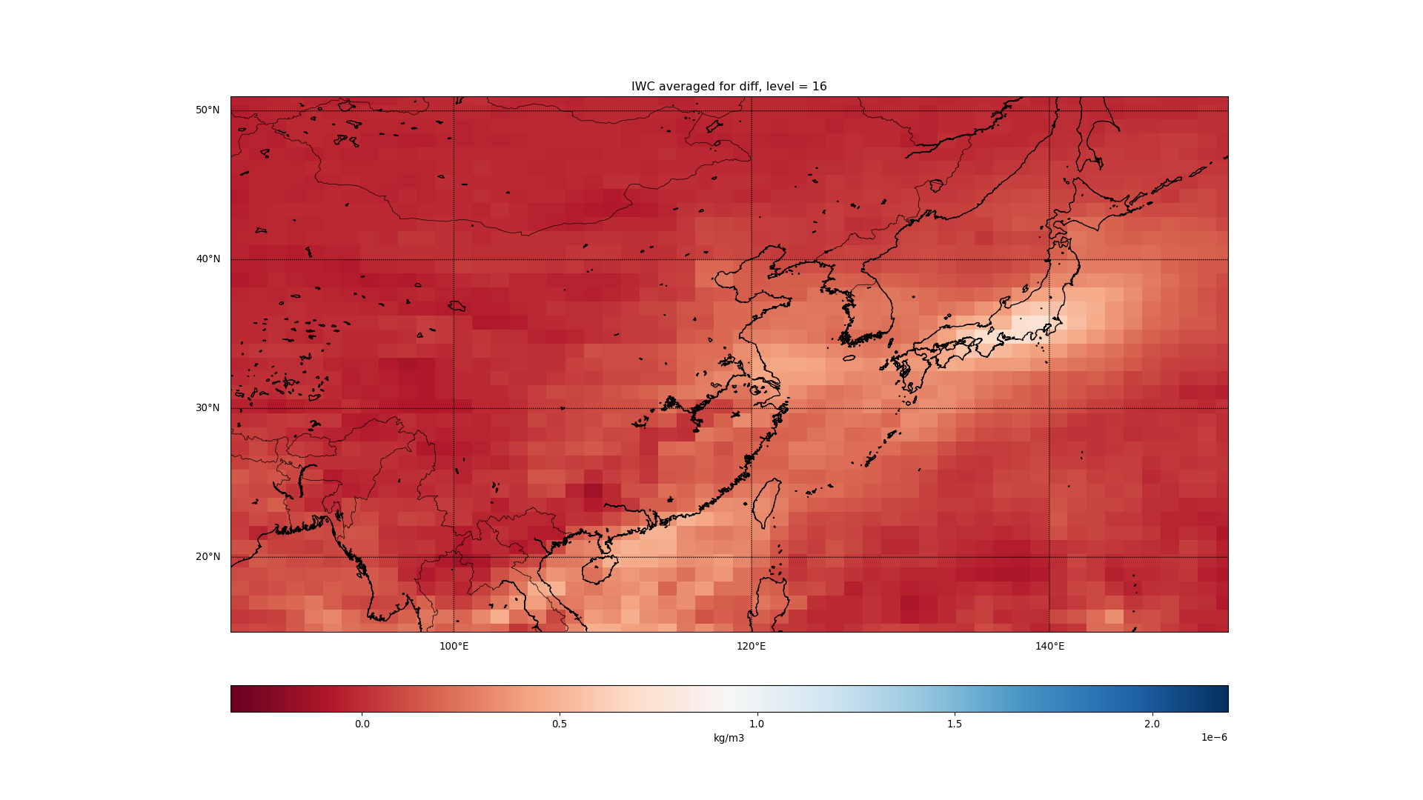

Slide 62
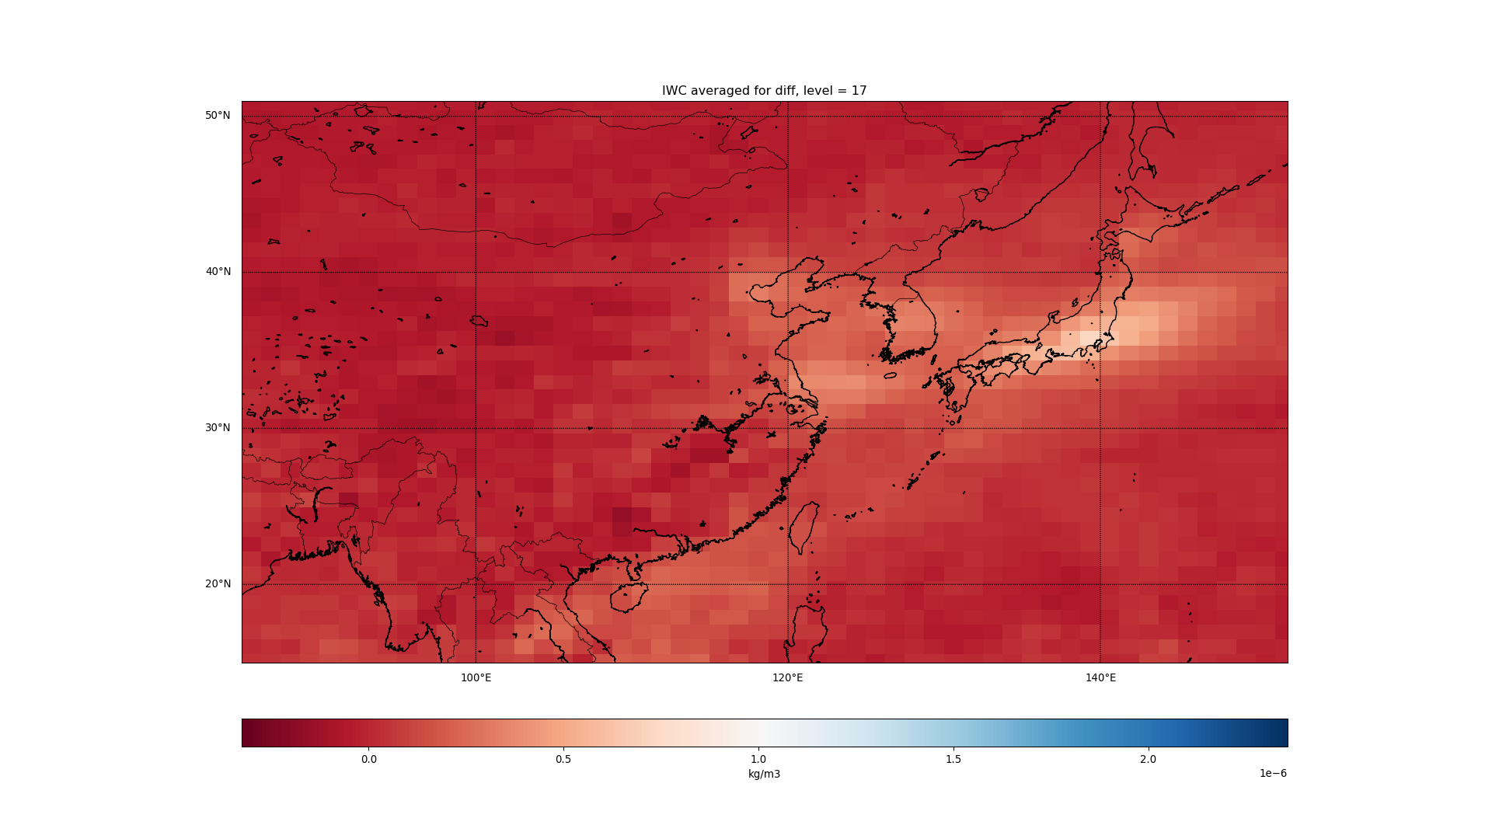

Slide 63
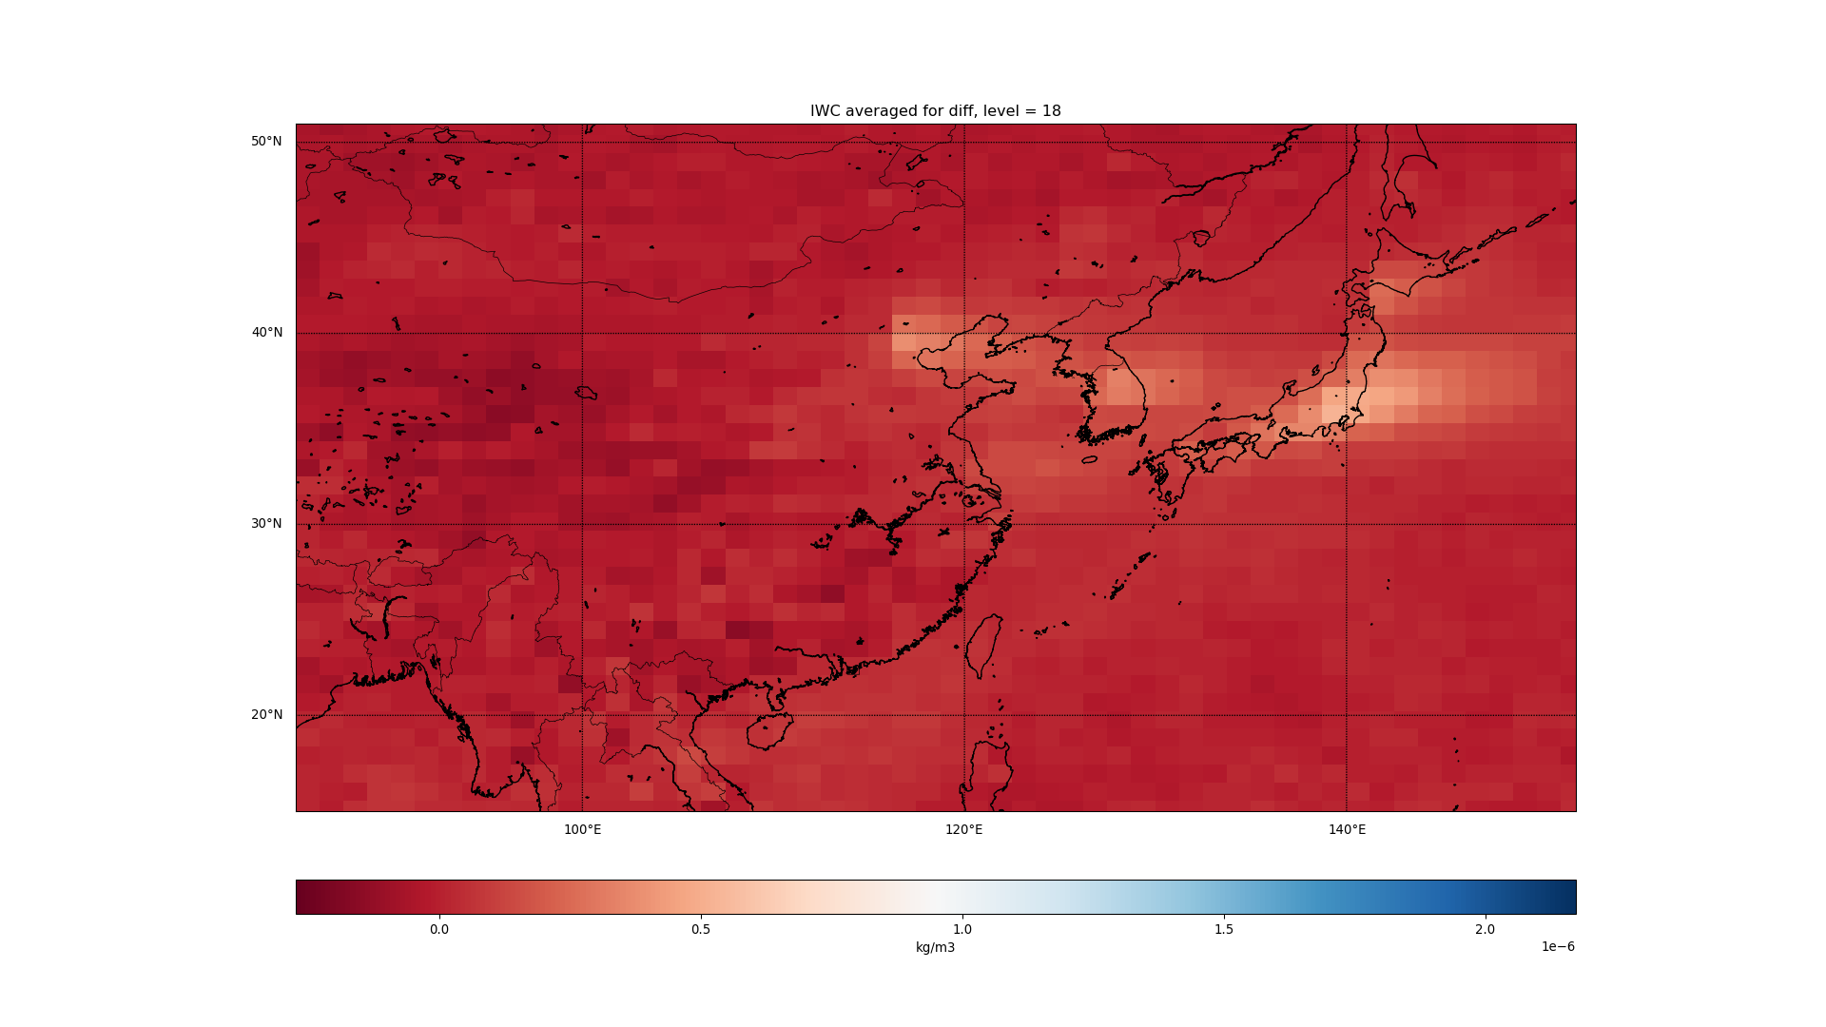

Slide 64
T: East Asia

Slide 65
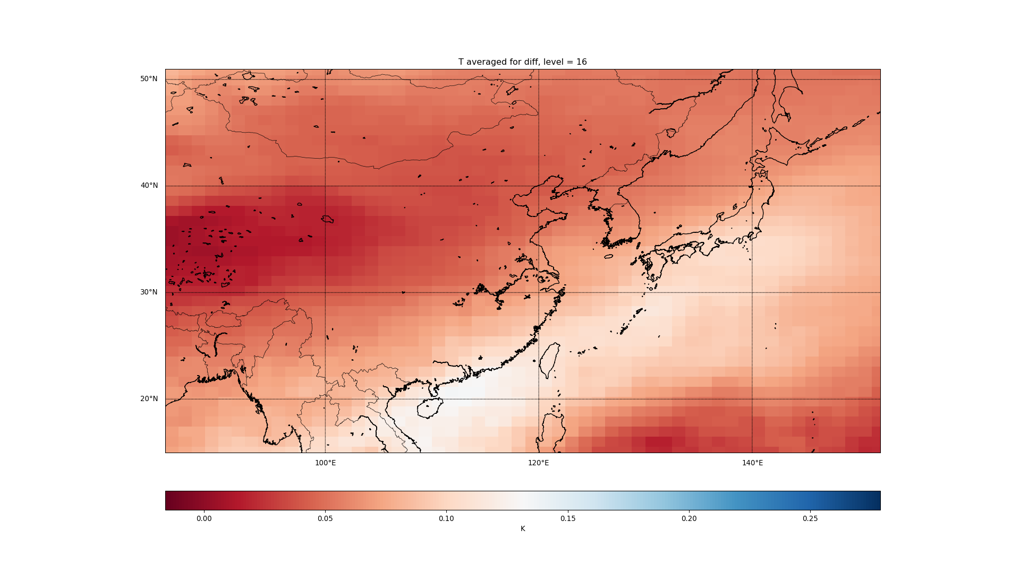

Slide 66
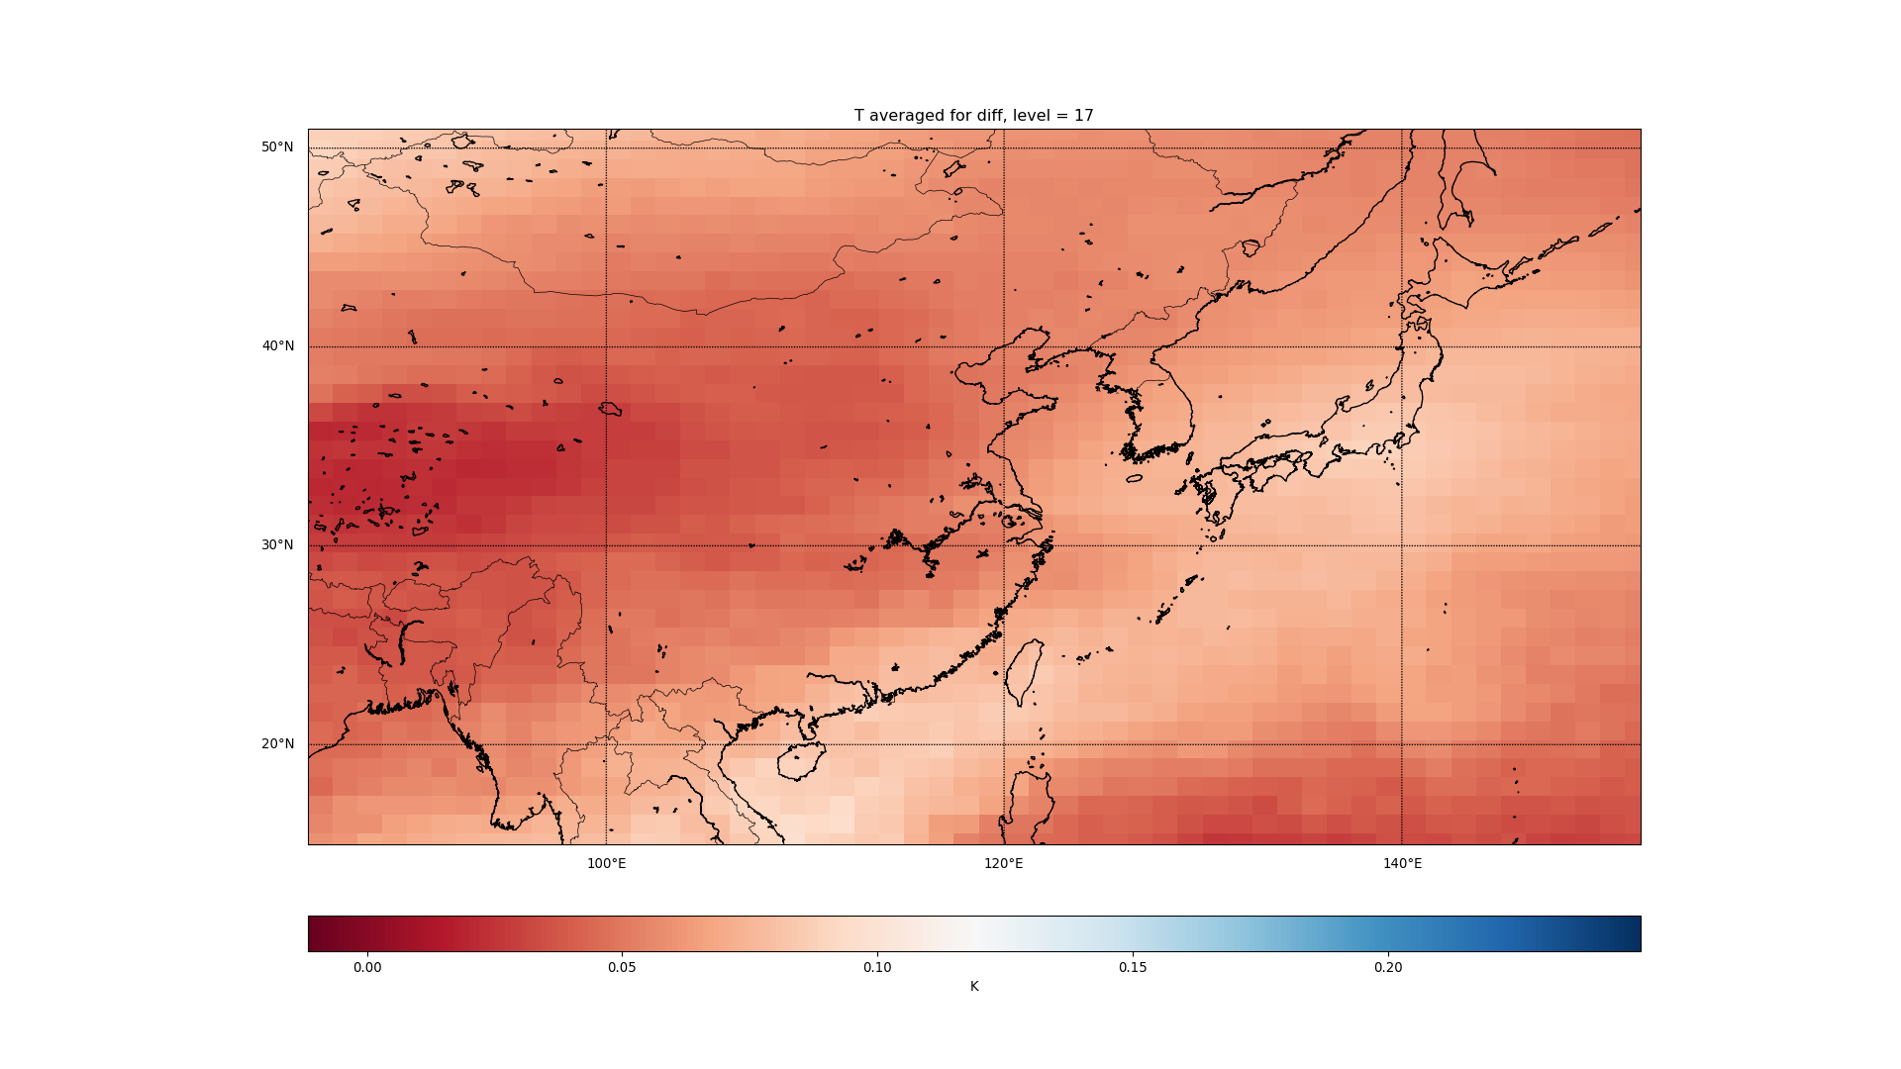

Slide 67
